Slide 1
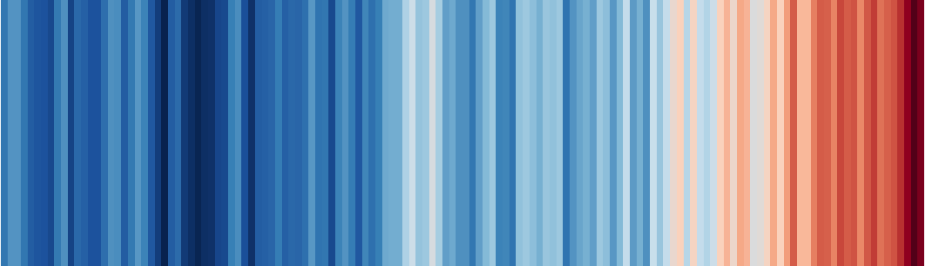
Visualizing information
EMSE 4197 | John Paul Helveston | January 29, 2020

Slide 2
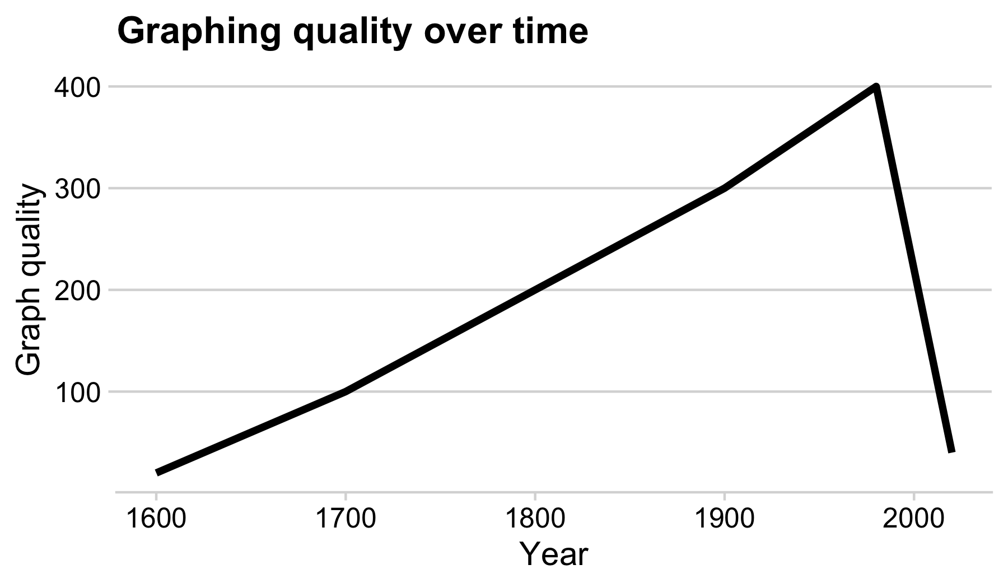

Slide 3
“Having word processing software doesn’t make us great writers.” - Stephen Few

Slide 4
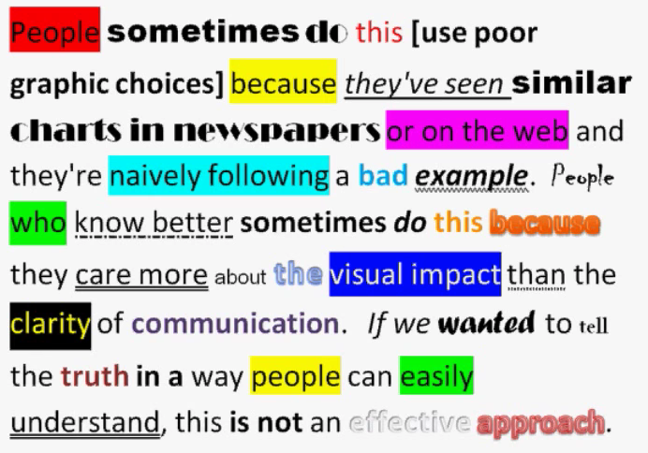
We don’t write paragraphs like this:
So don’t make graphs like this:
Image from Few (2012, pg. 227)
Image from excelcharts.com

Slide 5
Good visualizations optimize for the human visual-memory system
5

Slide 6
A (very) simplified model of visual-memory system
Iconic memory
< 1 sec.
“Pre-attentive”
Attention “grabbed”
Working memory
< few hours
Limited (3-4 chunks)
Information / main message
Effect graphs focus on this
Long-term memory
Lifetime

Slide 7
Two objectives of effective graphs:
Grab & direct attention (iconic memory)
Reduce processing demands (working memory)

Slide 8
The power of pre-attentive processing
Count all the “5”s:
821134907856412043612
304589640981709812734
123450986124790812734
029860192837401489363
123479827961203459816
234009816256908127634
123459087162342015237
123894789237498230192

Slide 9
The power of pre-attentive processing
Count all the “5”s:
821134907856412043612
304589640981709812734
123450986124790812734
029860192837401489363
123479827961203459816
234009816256908127634
123459087162342015237
123894789237498230192

Slide 10
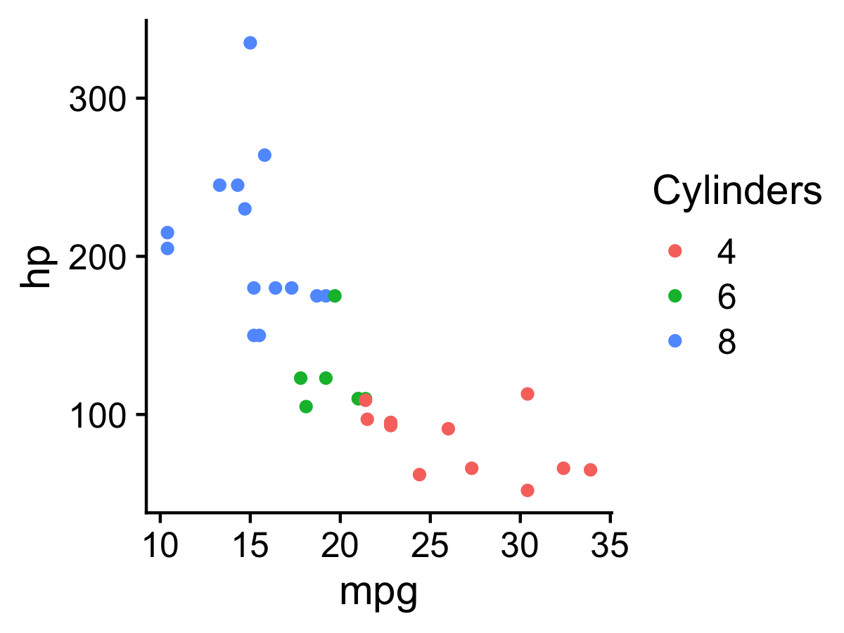
Pre-attentive attributes
Quantitative data
Categorical data

Slide 11
Not all pre-attentive attributes are equal
11

Slide 12
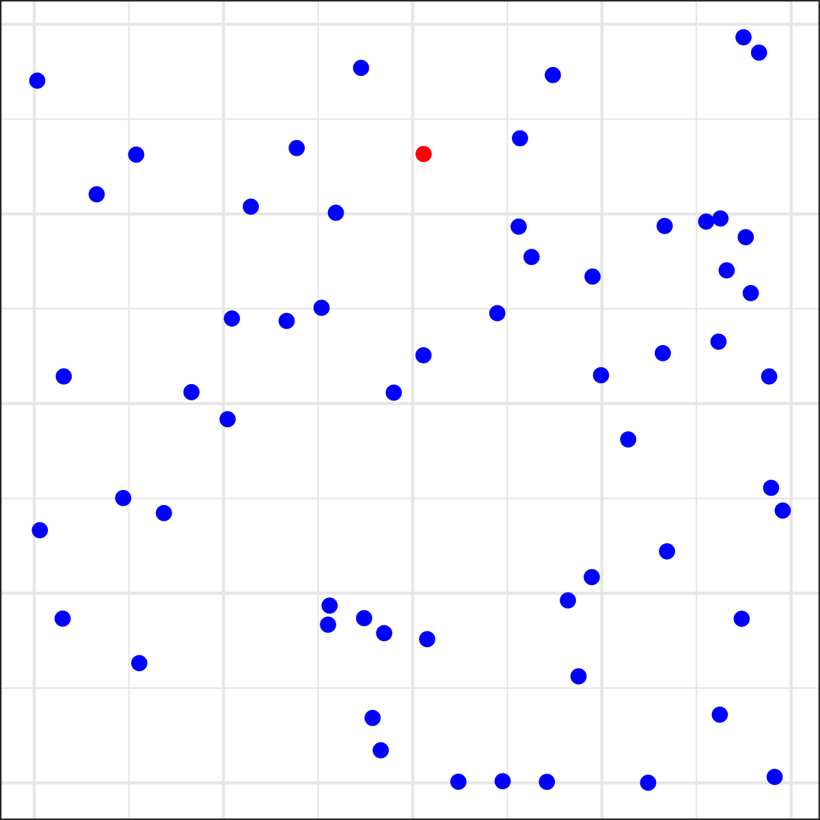
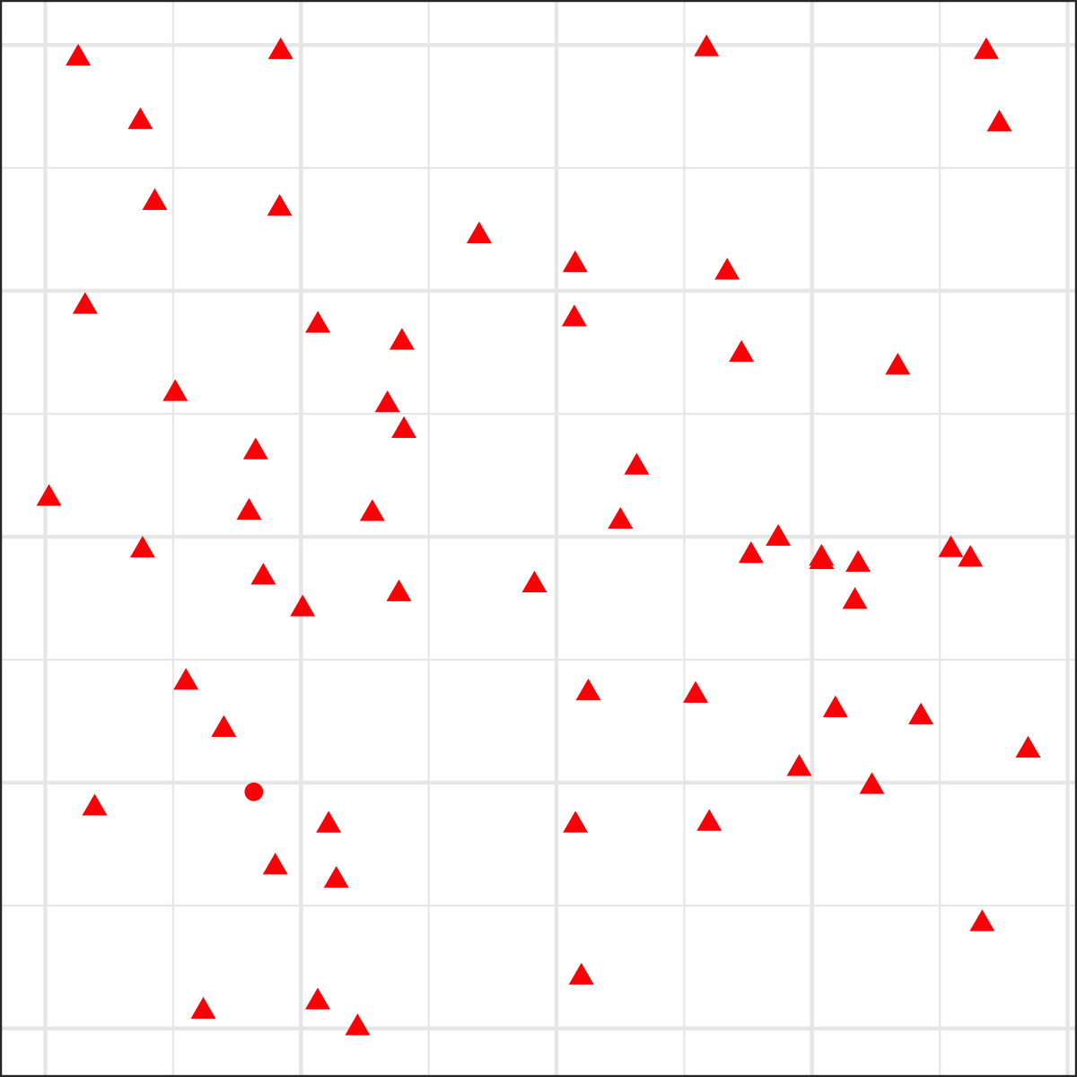
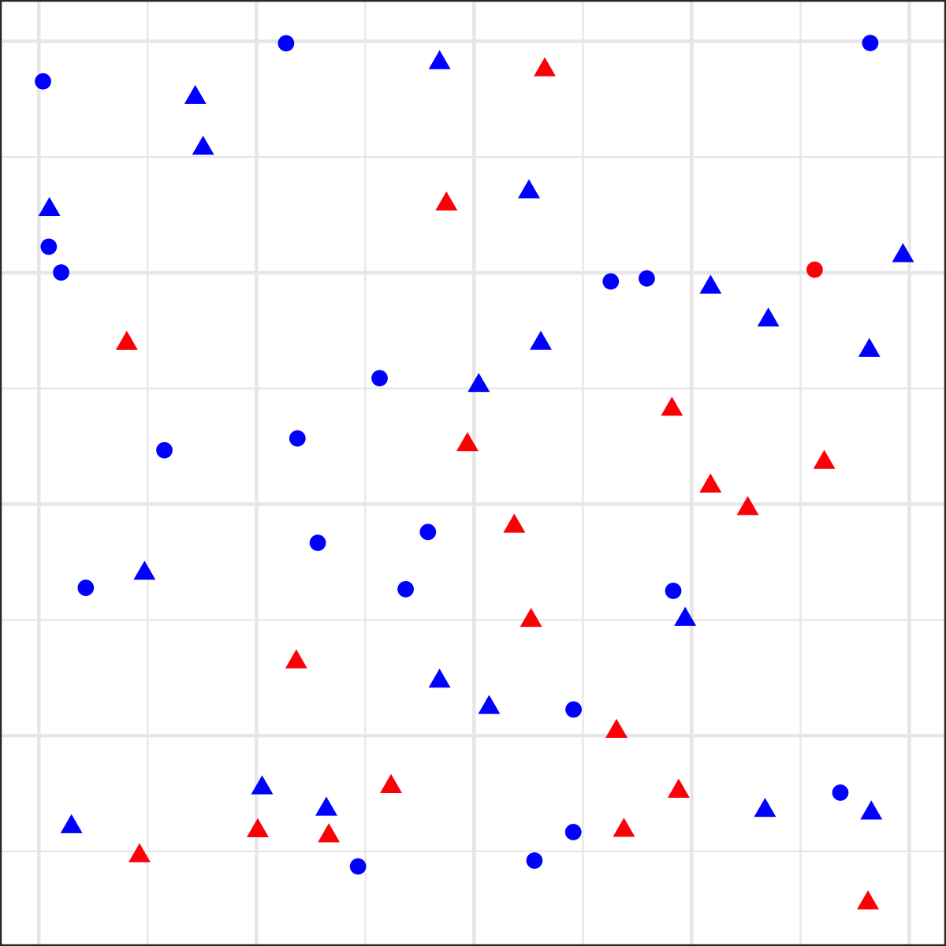
Is there a red dot?

Slide 13
For categorical data
Hue > Shape
Less is more

Slide 14
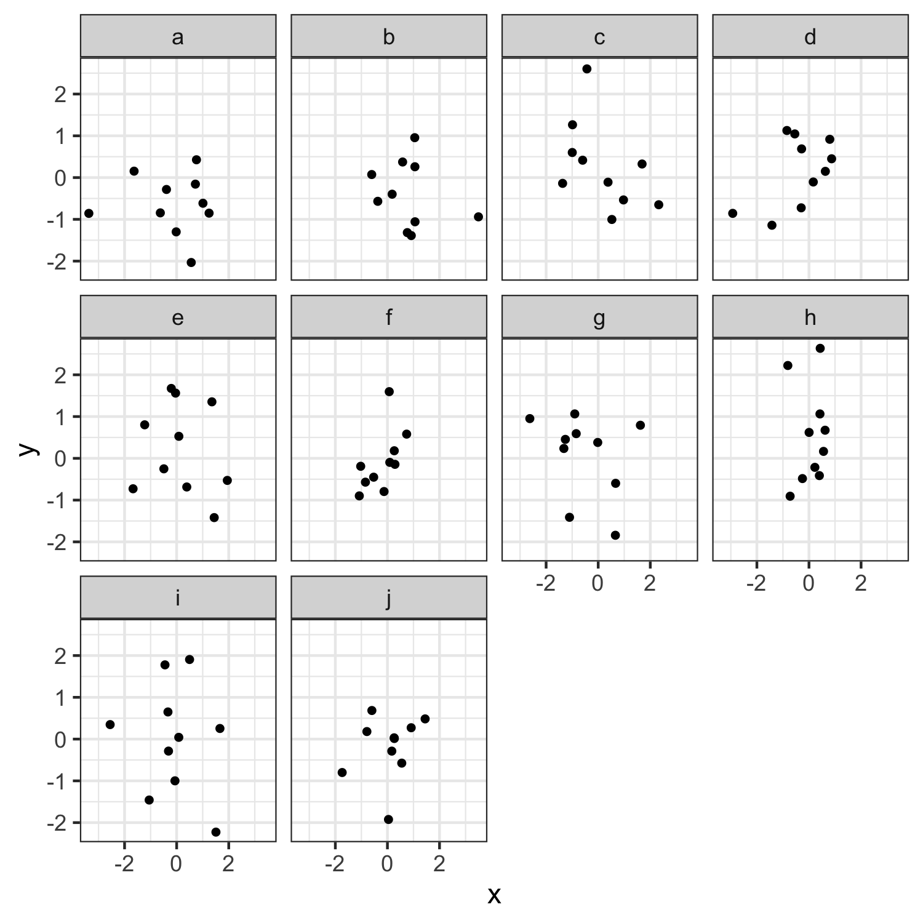
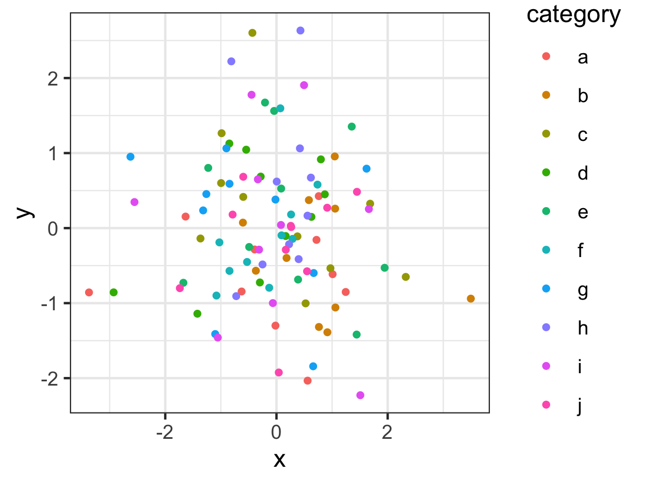

Slide 15
Graph components
15

Slide 16
Graph components
Geoms:
points, lines, boxes, bars, etc.

Slide 17
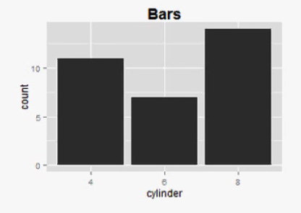
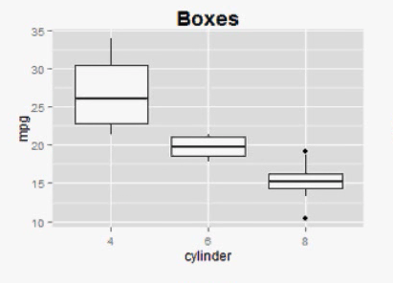
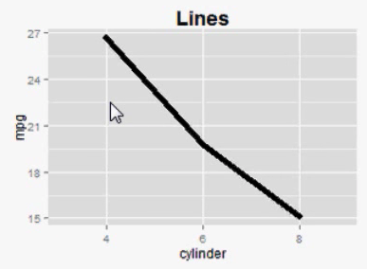
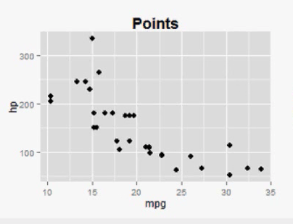
Geoms: geometric shapes used to represent data

Slide 18
Graph components
Geoms:
points, lines, boxes, bars, etc.
Pre-attentive attributes:
position, color, shape, curvature, etc.
Non-data ink:
scales, grid lines, legend, labels, etc.
No “chart junk” (Tufte, 2001)

Slide 19
“Erase non-data ink.” - Edward Tufte

Slide 20
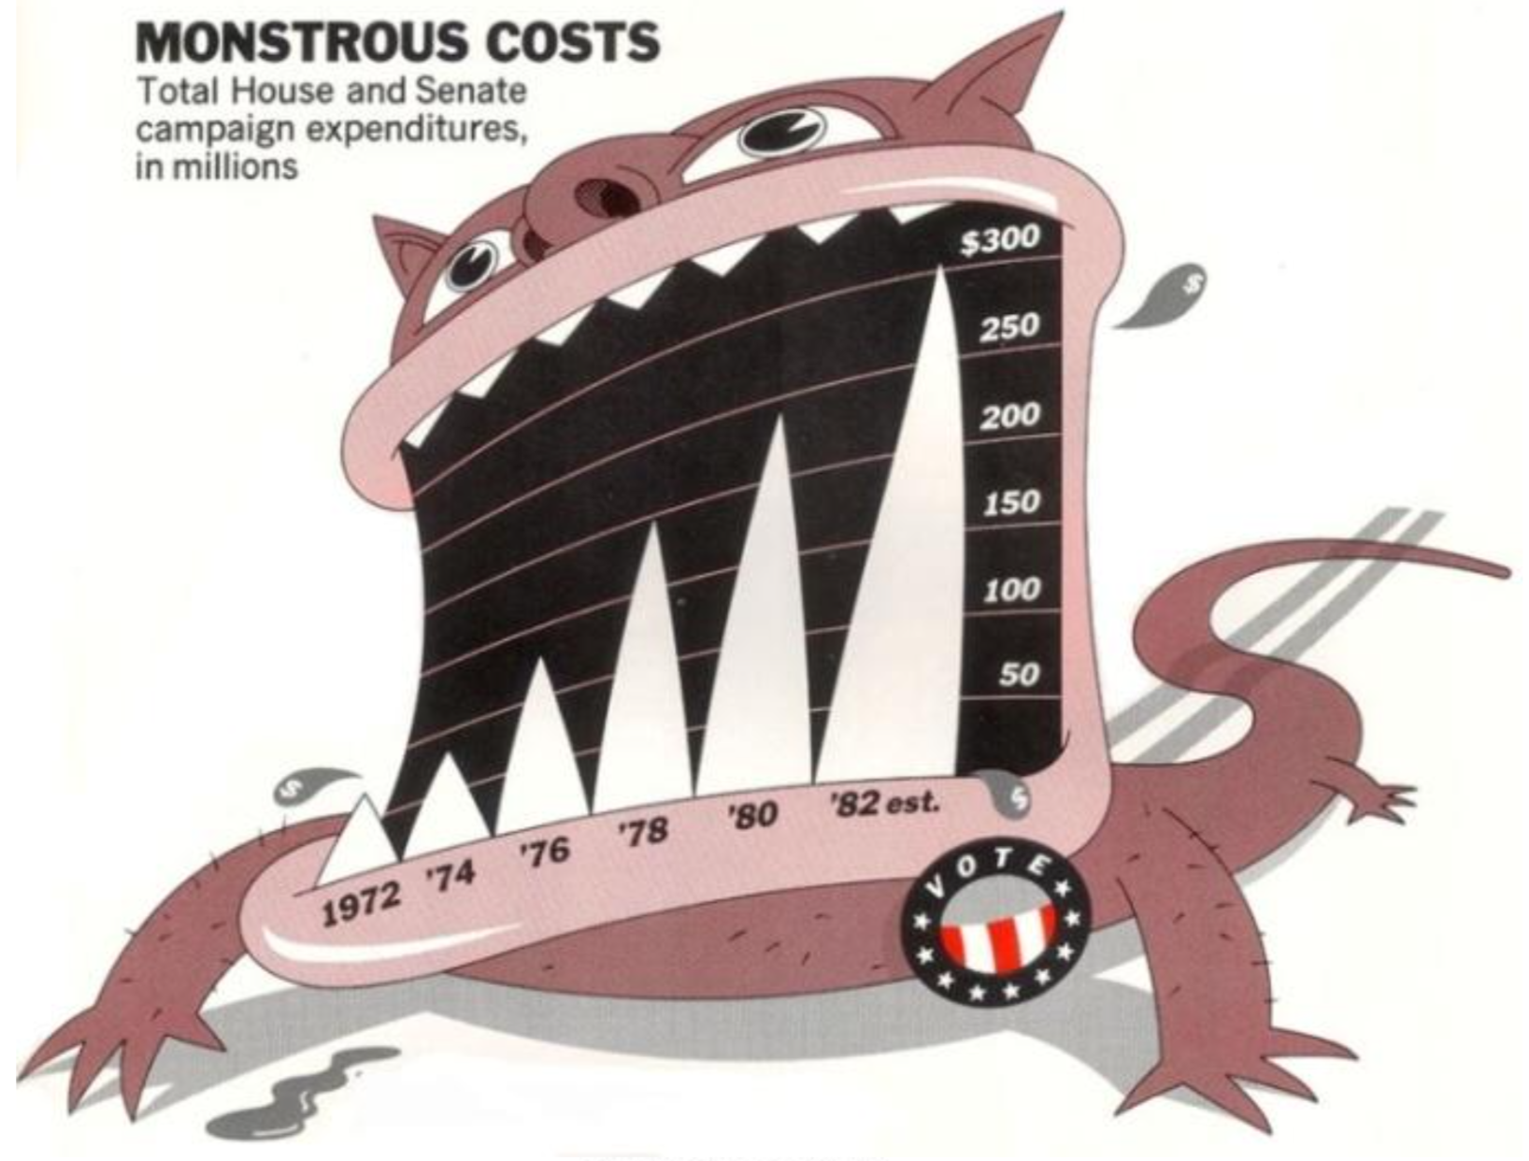
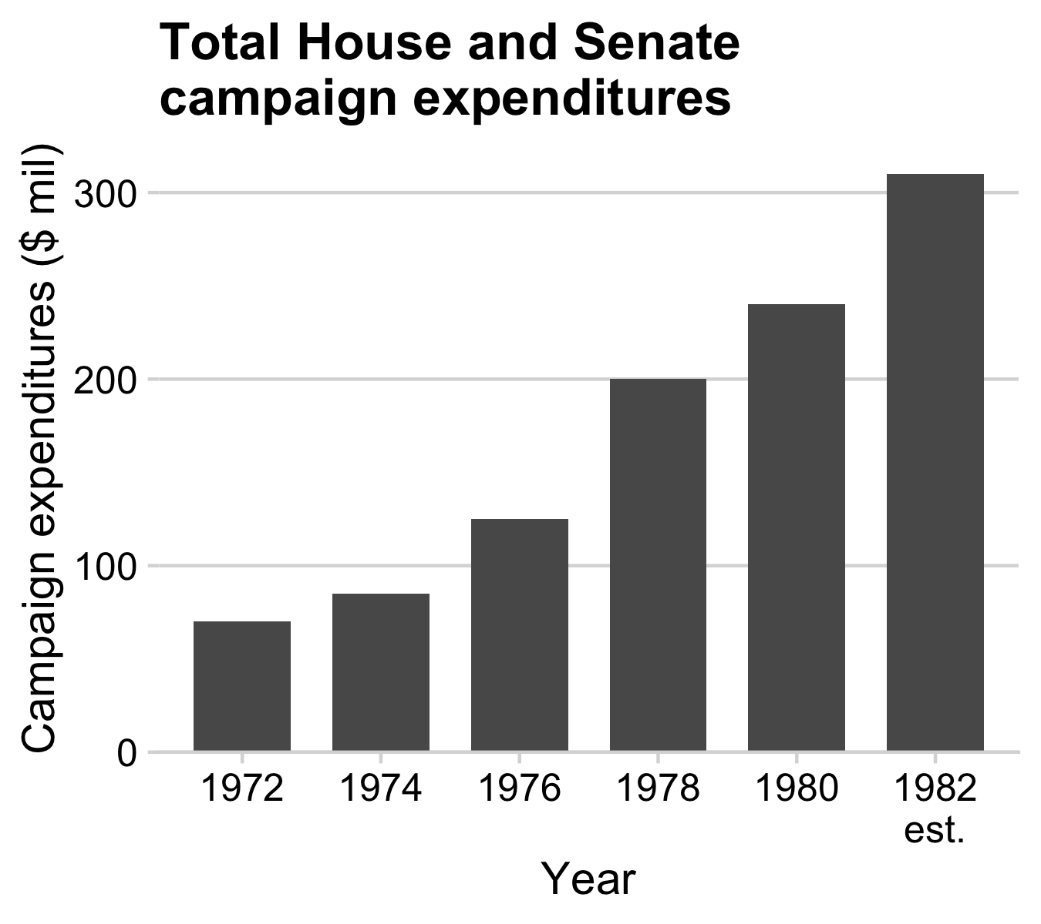
Figure 1.6: `Monstrous Costs’ by Nigel Holmes, in Healy, 2018

Slide 21
Lessons from Psychology research
21

Slide 22
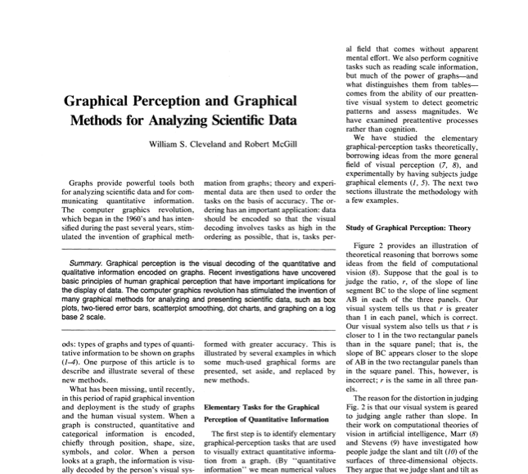
Cleveland, W. S., & McGill, R. (1985). Graphical perception and graphical methods for analyzing scientific data. Science, New Series, 229(4716), 828-833.

Slide 23
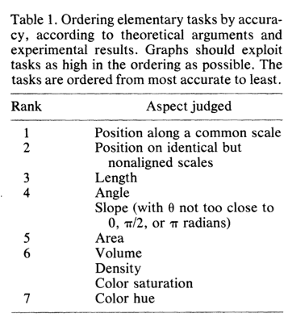
Cleveland, W. S., & McGill, R. (1985). Graphical perception and graphical methods for analyzing scientific data. Science, New Series, 229(4716), 828-833.

Slide 24
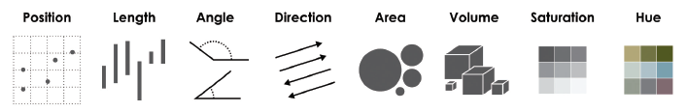
Pattern recognition hierarchy:
← More accurate
Less accurate →

Slide 25
Full disclosure:
Much of the next 50-ish slides are from John Rauser’s talk on YouTube
25

Slide 26
Cleveland’s three visual operations of pattern perception:
Estimation
Assembly
Detection
Discrimination X != Y
Ranking X > Y
Ratioing X / Y
26

Slide 27
“At the heart of quantitative reasoning is a single question: compared to what?” - Edward Tufte

Slide 28
Position on a common scale
Position on non-aligned scales
Length
Angle
Area
Color saturation
Color hue

Slide 29
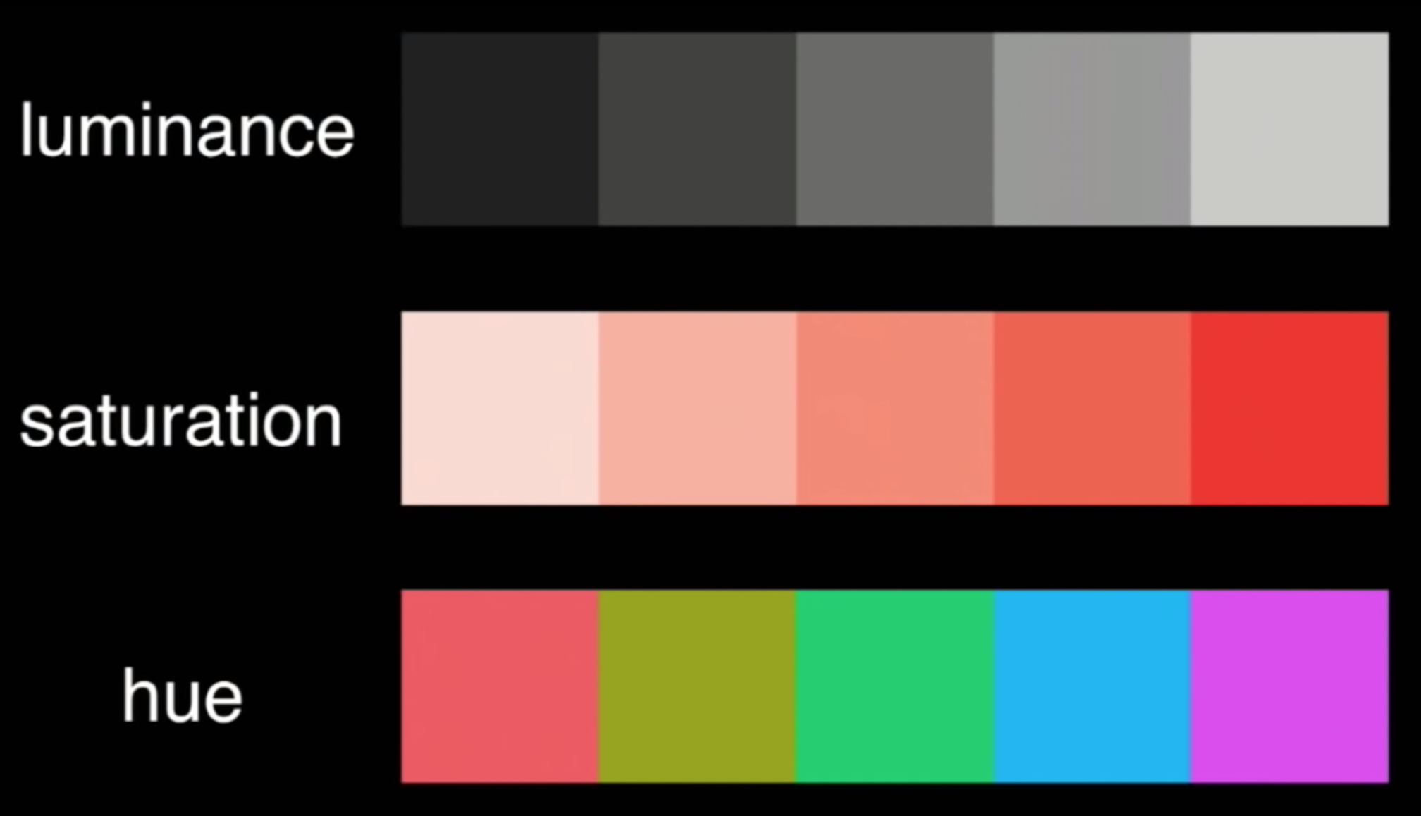

Slide 30
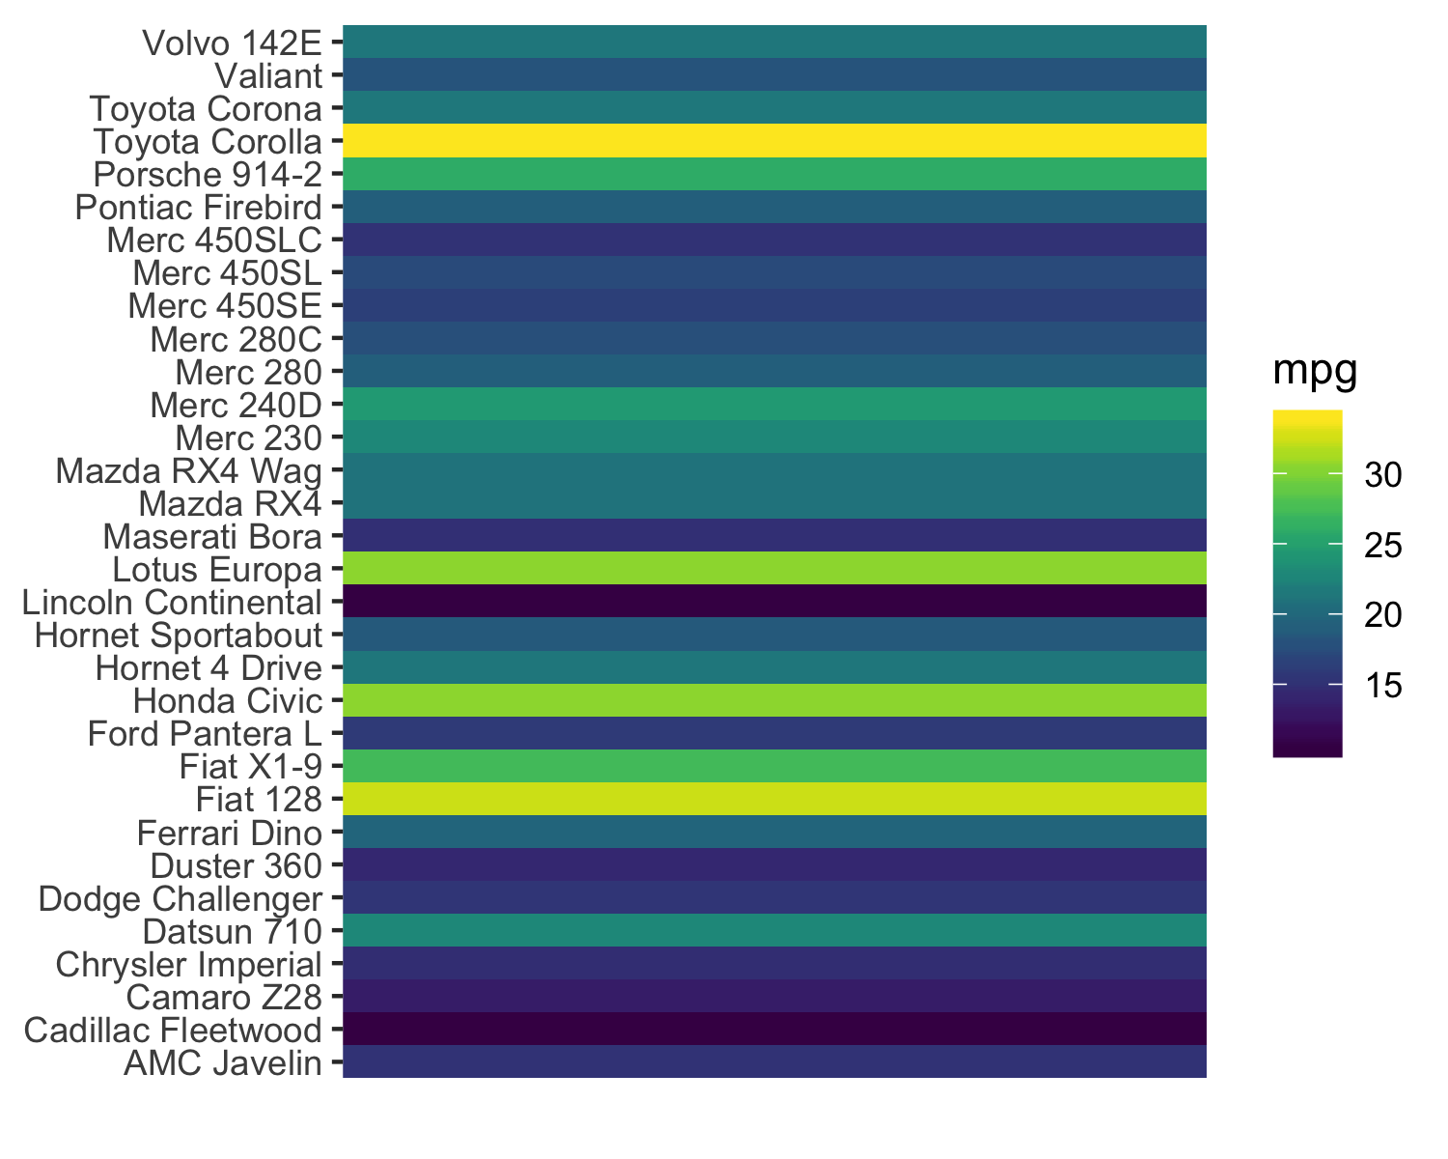
Position on a common scale
Position on non-aligned scales
Length
Angle
Area
Color saturation
Color hue
Discrimination?

Slide 31
Position on a common scale
Position on non-aligned scales
Length
Angle
Area
Color saturation
Color hue
Discrimination?

Slide 32
Position on a common scale
Position on non-aligned scales
Length
Angle
Area
Color saturation
Color hue
Ranking?

Slide 33
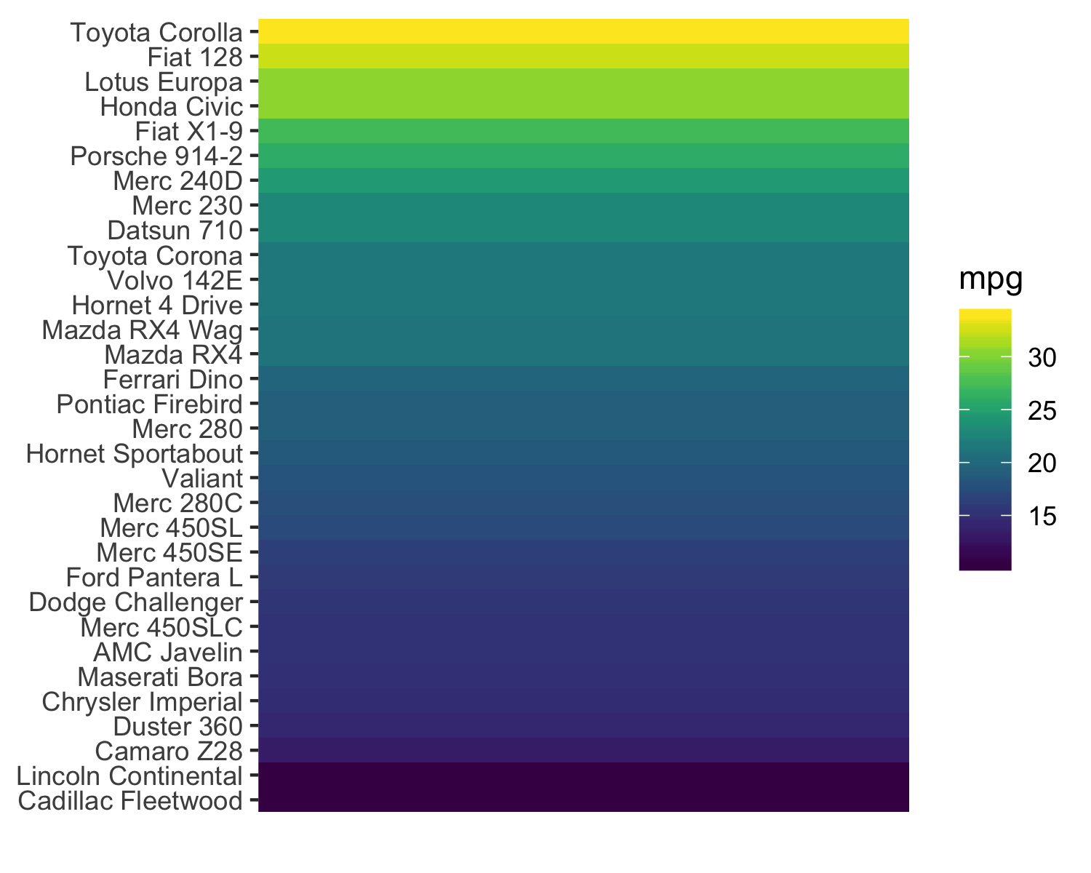
Position on a common scale
Position on non-aligned scales
Length
Angle
Area
Color saturation
Color hue
Ranking?

Slide 34
Position on a common scale
Position on non-aligned scales
Length
Angle
Area
Color saturation
Color hue
Discrimination?

Slide 35
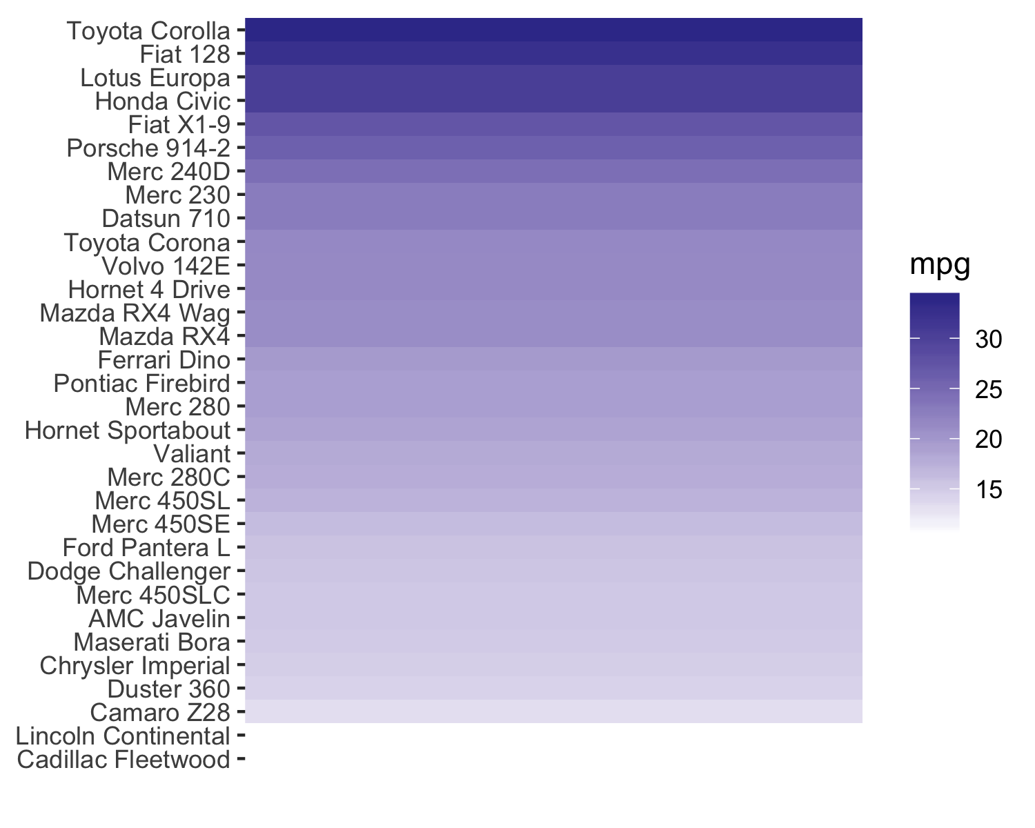
Position on a common scale
Position on non-aligned scales
Length
Angle
Area
Color saturation
Color hue

Slide 36
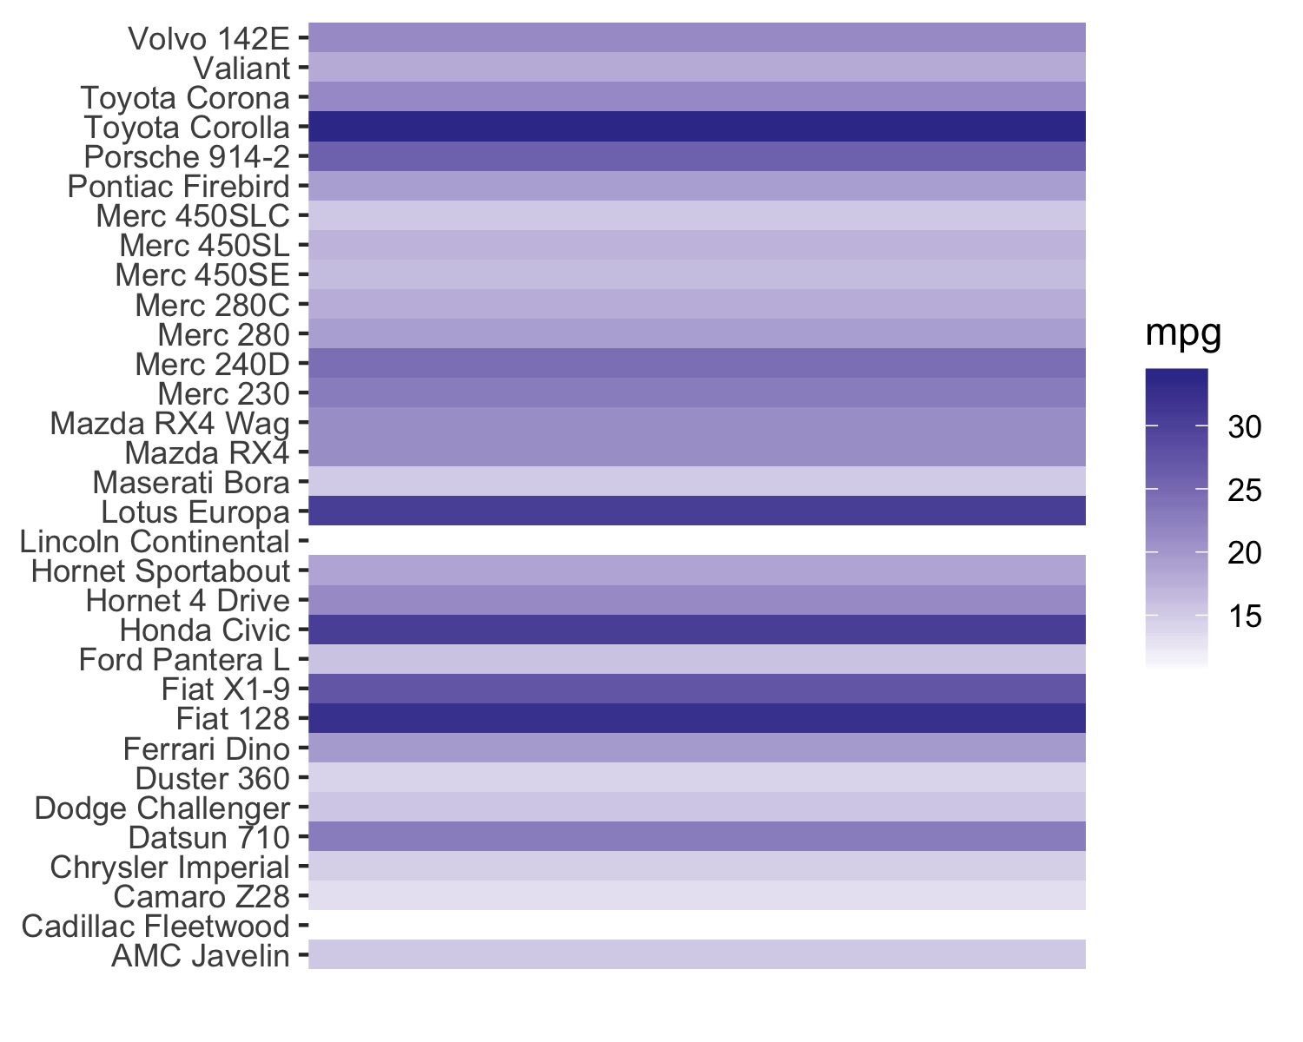
Position on a common scale
Position on non-aligned scales
Length
Angle
Area
Color saturation
Color hue

Slide 37
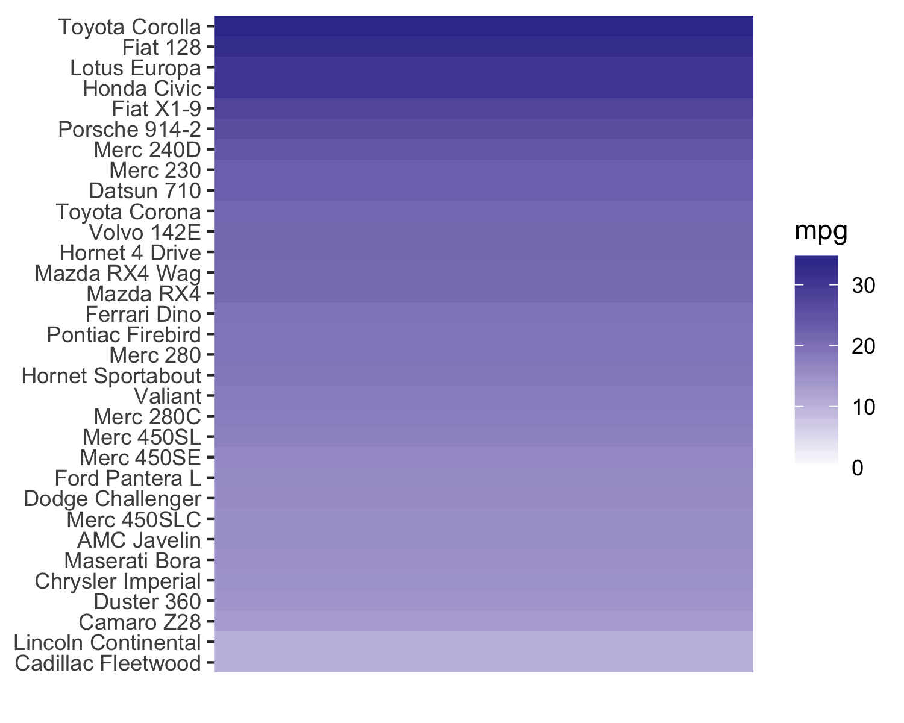
Position on a common scale
Position on non-aligned scales
Length
Angle
Area
Color saturation
Color hue
Ratioing?

Slide 38
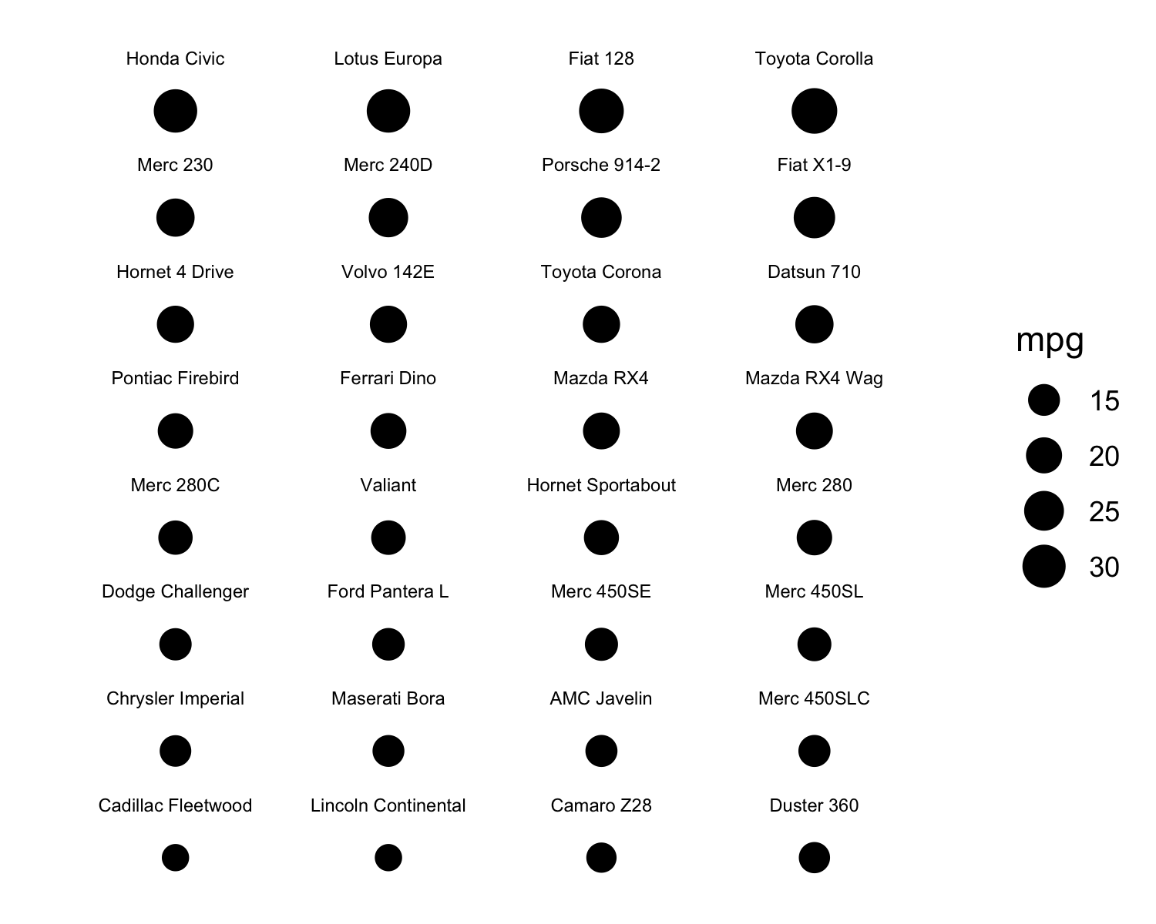
Position on a common scale
Position on non-aligned scales
Length
Angle
Area
Color saturation
Color hue
Ratioing?

Slide 39
Position on a common scale
Position on non-aligned scales
Length
Angle
Area
Color saturation
Color hue
Discrimination?
Ranking?

Slide 40
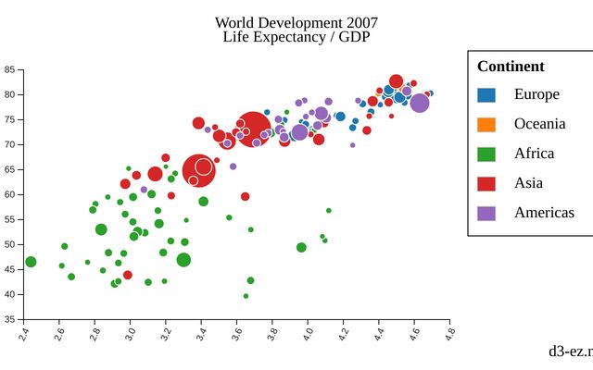
Position on a common scale
Position on non-aligned scales
Length
Angle
Area
Color saturation
Color hue

Slide 41
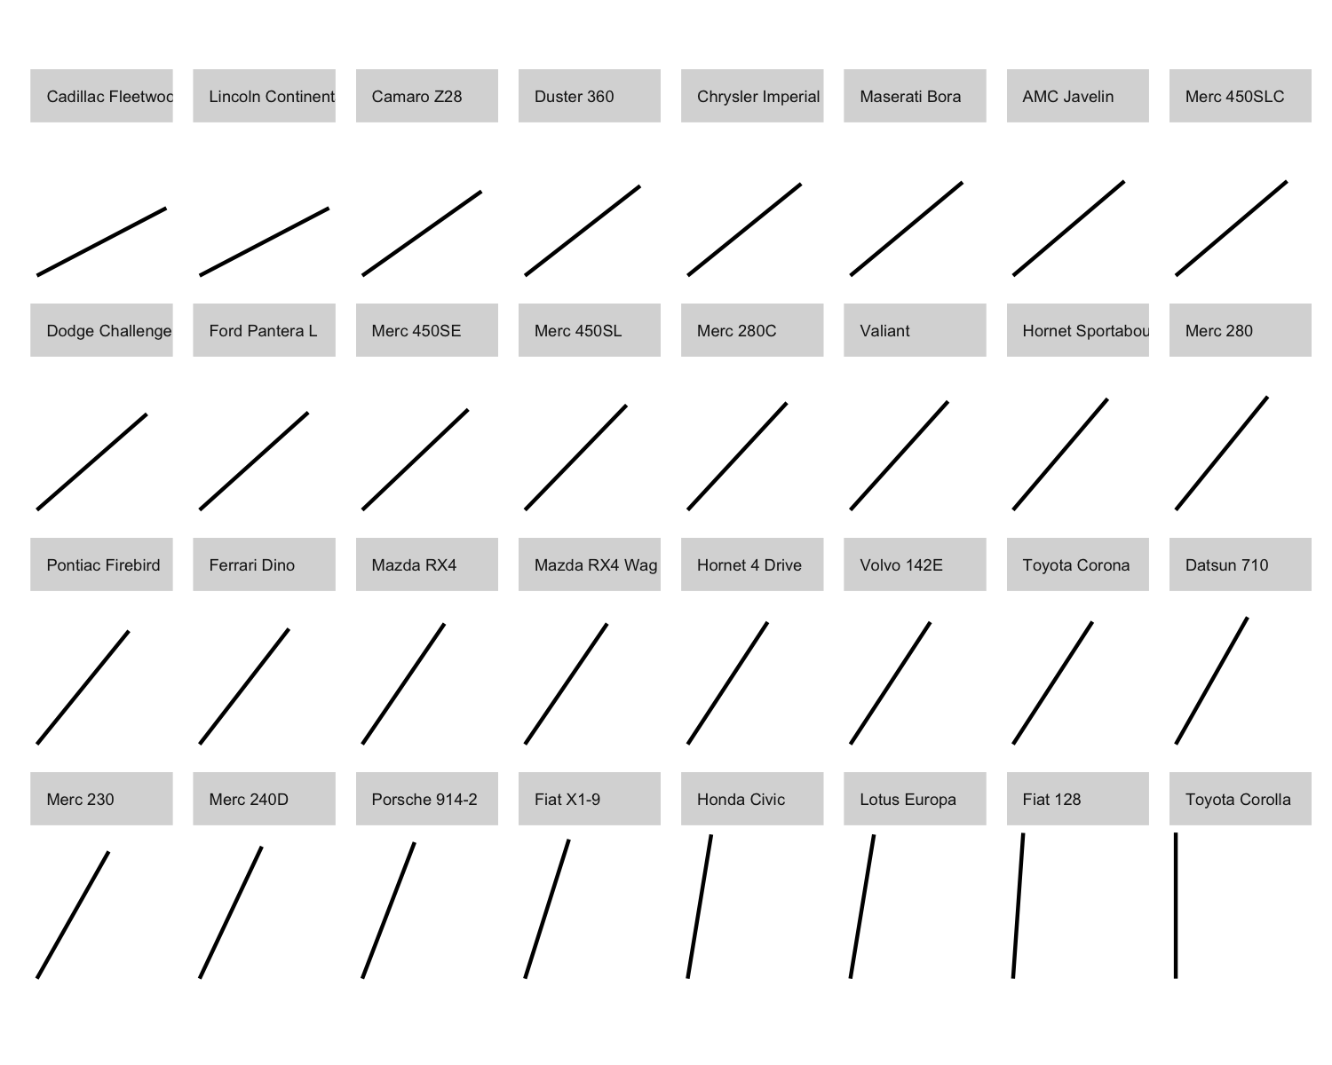
Position on a common scale
Position on non-aligned scales
Length
Angle
Area
Color saturation
Color hue
Ratioing?

Slide 42
Position on a common scale
Position on non-aligned scales
Length
Angle
Area
Color saturation
Color hue
Discrimination?
Ranking?

Slide 43
Position on a common scale
Position on non-aligned scales
Length
Angle
Area
Color saturation
Color hue

Slide 44
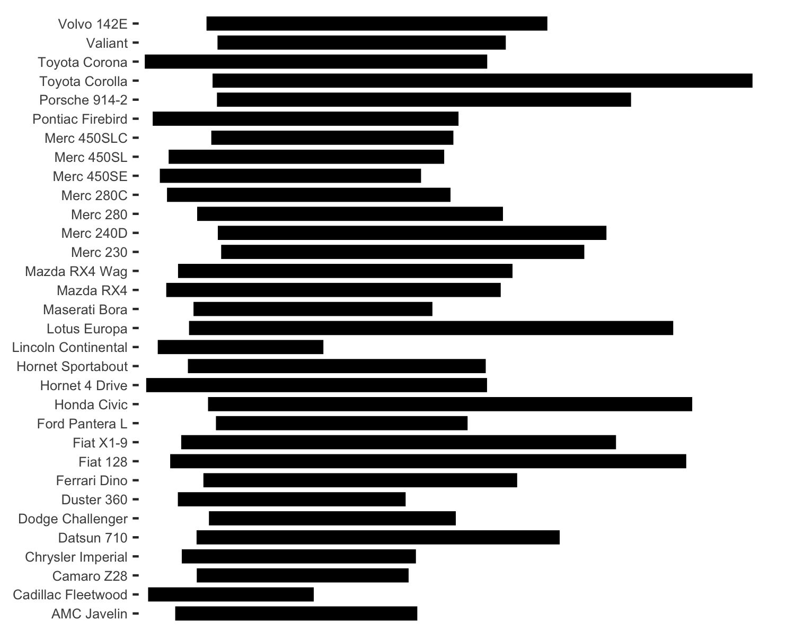
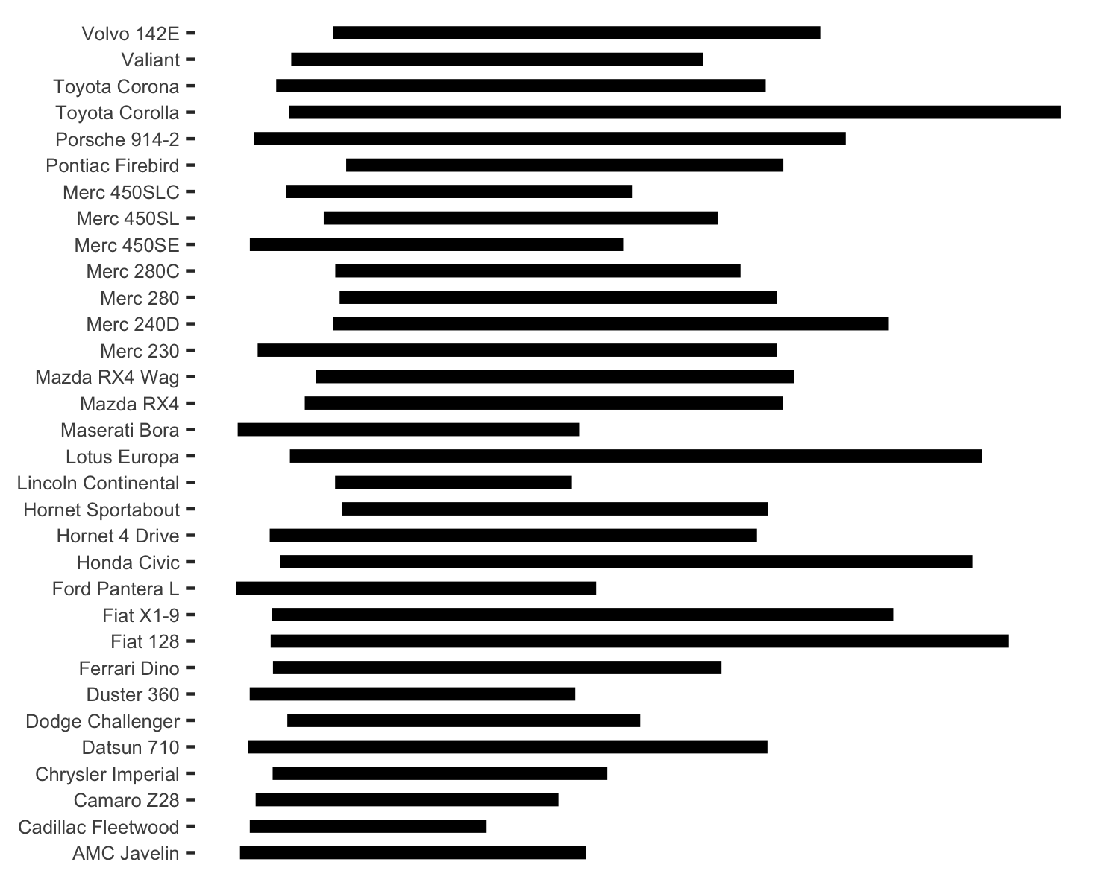
Position on a common scale
Position on non-aligned scales
Length
Angle
Area
Color saturation
Color hue
Ratioing?
15 mpg

Slide 45
Position on a common scale
Position on non-aligned scales
Length
Angle
Area
Color saturation
Color hue
Discrimination?
Ranking?
15 mpg

Slide 46
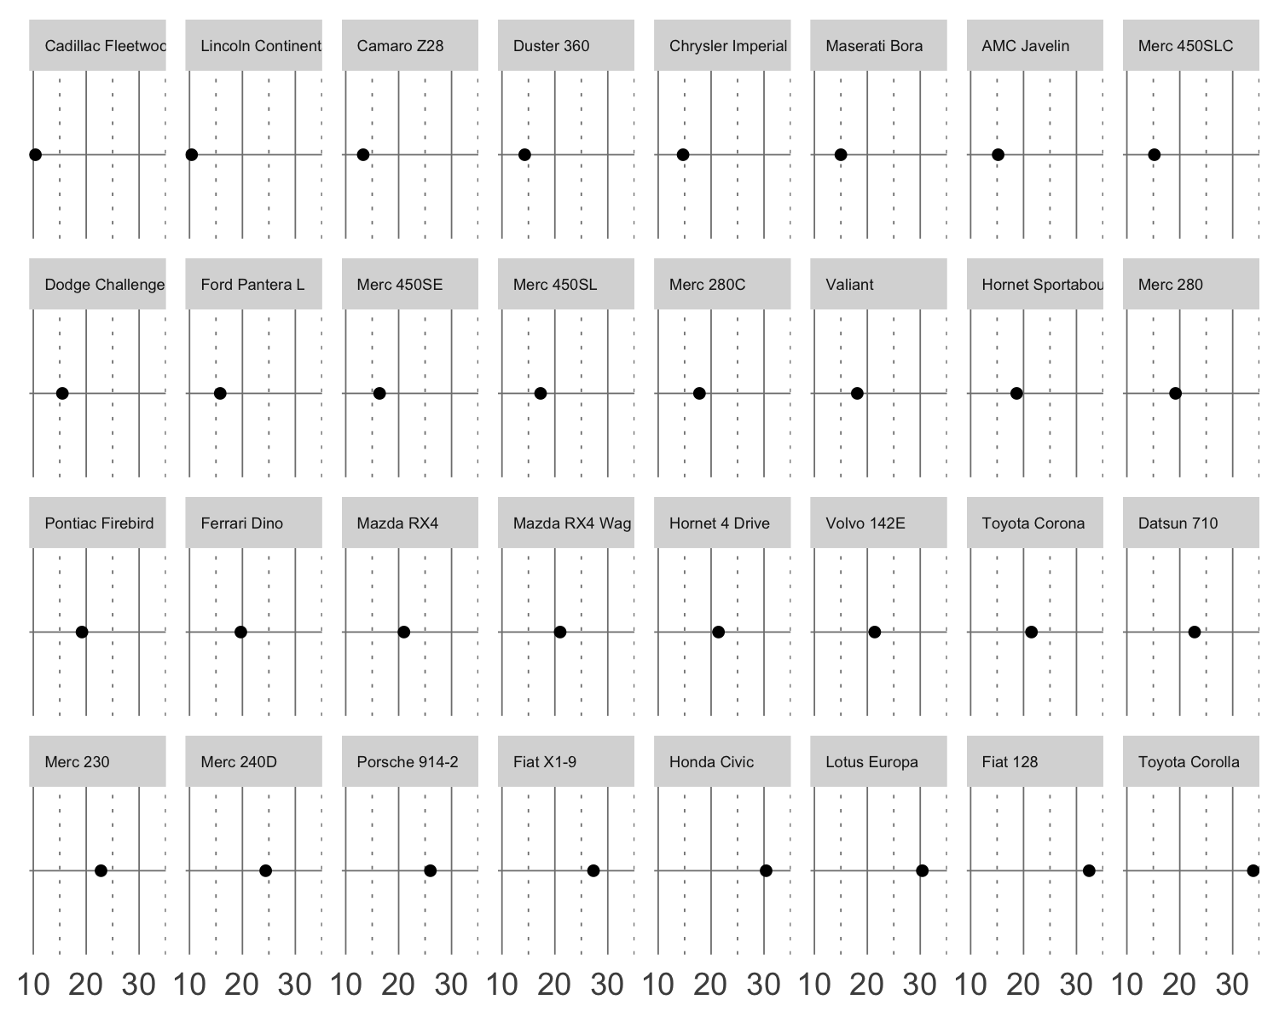
Position on a common scale
Position on non-aligned scales
Length
Angle
Area
Color saturation
Color hue
Discrimination?
Ranking?

Slide 47
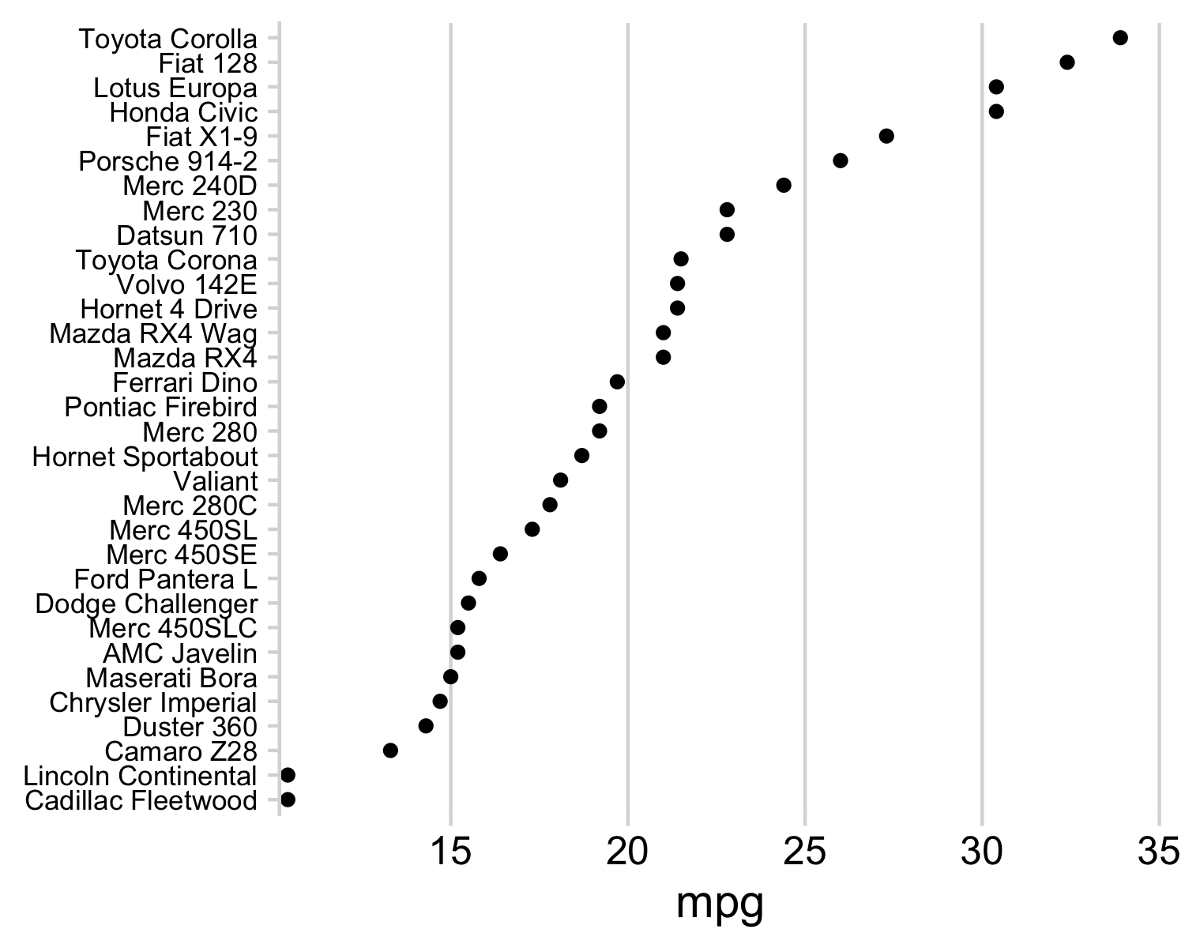
Position on a common scale
Position on non-aligned scales
Length
Angle
Area
Color saturation
Color hue
Ratioing?

Slide 48
Position on a common scale
Position on non-aligned scales
Length
Angle
Area
Color saturation
Color hue
Discrimination?
Ranking?

Slide 49
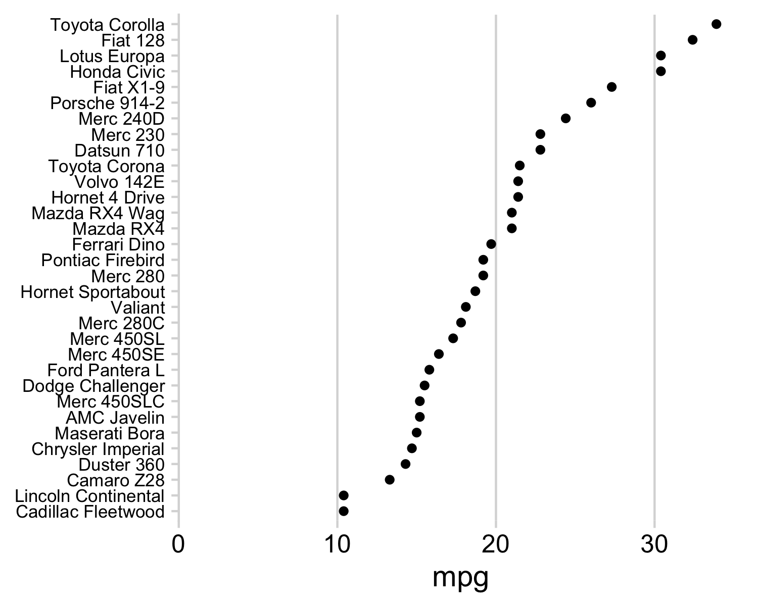
Position on a common scale
Position on non-aligned scales
Length
Angle
Area
Color saturation
Color hue
No need to scale to 0:
Lowers resolution
Isn't needed for accurate ratioing

Slide 50
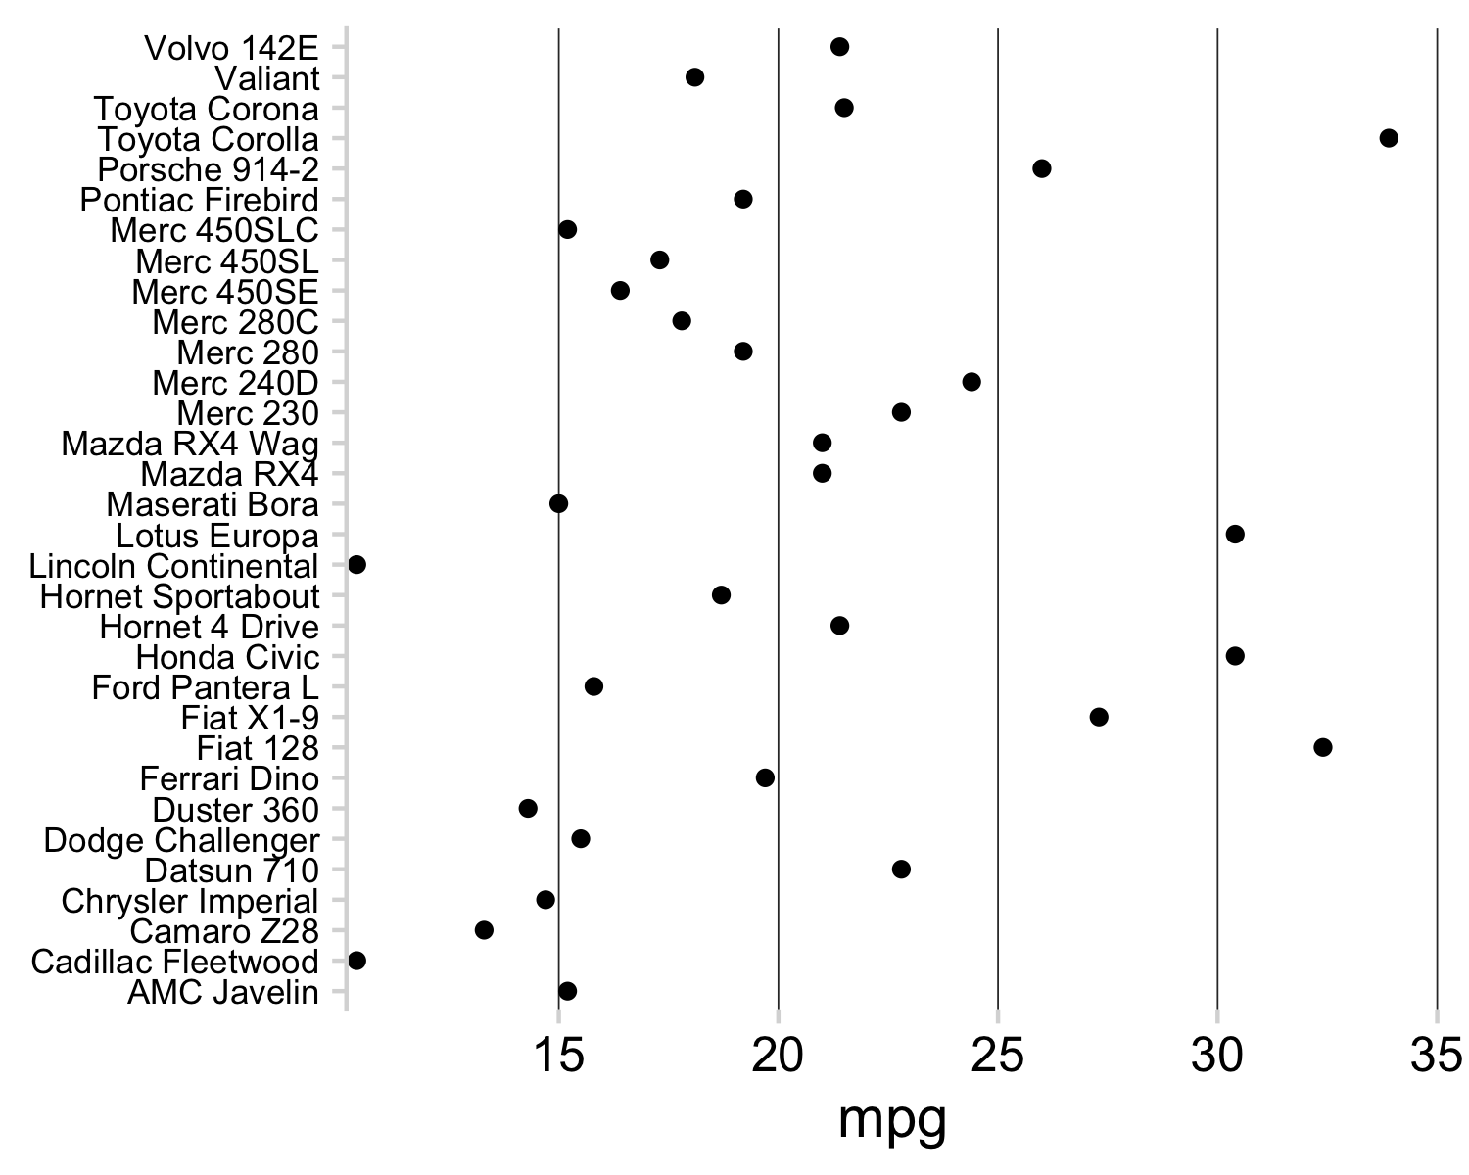
Position on a common scale
Position on non-aligned scales
Length
Angle
Area
Color saturation
Color hue
Ordering still crucial

Slide 51
Cleveland’s three visual operations of pattern perception:
Estimation
Assembly
Detection
The grouping of graphical elements
51

Slide 52
Gestalt Psychology
The whole has a reality that is entirely separate from the parts
52

Slide 53

Notes:
You experience more special information than is explicitly present in an image

Slide 54

Reification
Notes:
You experience more information than is explicitly present in an image

Slide 55
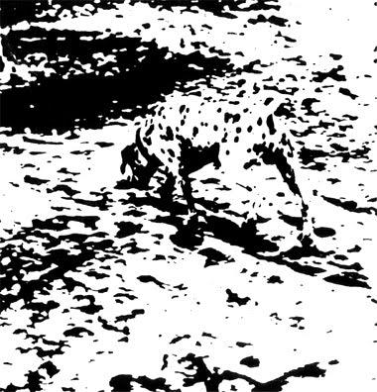
Emergence

Slide 56
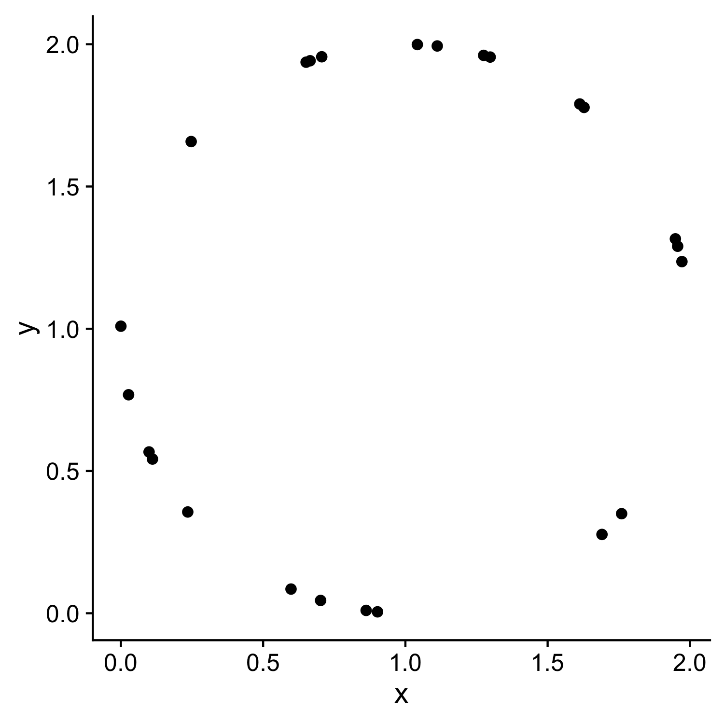
X | y
1.972 | 1.236
1.112 | 1.994
0 | 1.009
0.665 | 1.942
0.235 | 0.356
0.247 | 1.658
1.275 | 1.961
0.702 | 0.045
1.76 | 0.35
1.691 | 0.277
1.628 | 1.778
1.957 | 1.29
0.111 | 0.542
0.902 | 0.005
0.598 | 0.085
1.613 | 1.79
1.298 | 1.955
0.651 | 1.937
1.949 | 1.316
0.099 | 0.567
0.862 | 0.01
0.027 | 0.768
0.706 | 1.956
1.042 | 1.999
Law of closure

Slide 57
Prägnanz
We strongly prefer to interpret stimuli as regular, simple, and orderly
57

Slide 59
Law of continuity
We will group together objects that follow an established direction

Slide 60
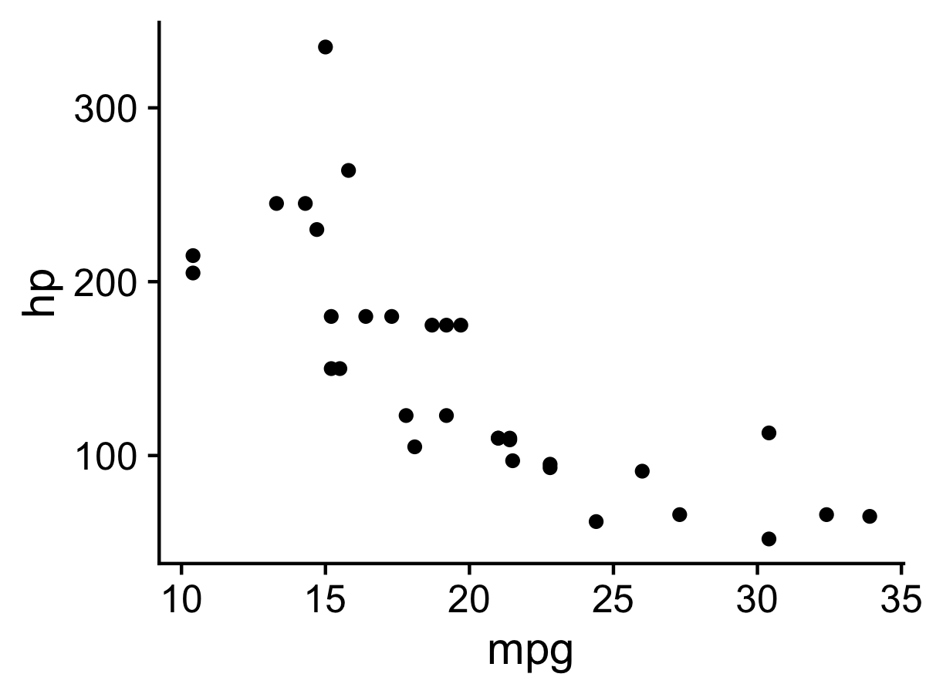
Law of continuity
We will group together objects that follow an established direction

Slide 61

Law of similarity
We tend to see elements that are physically similar as part of the same object

Slide 62
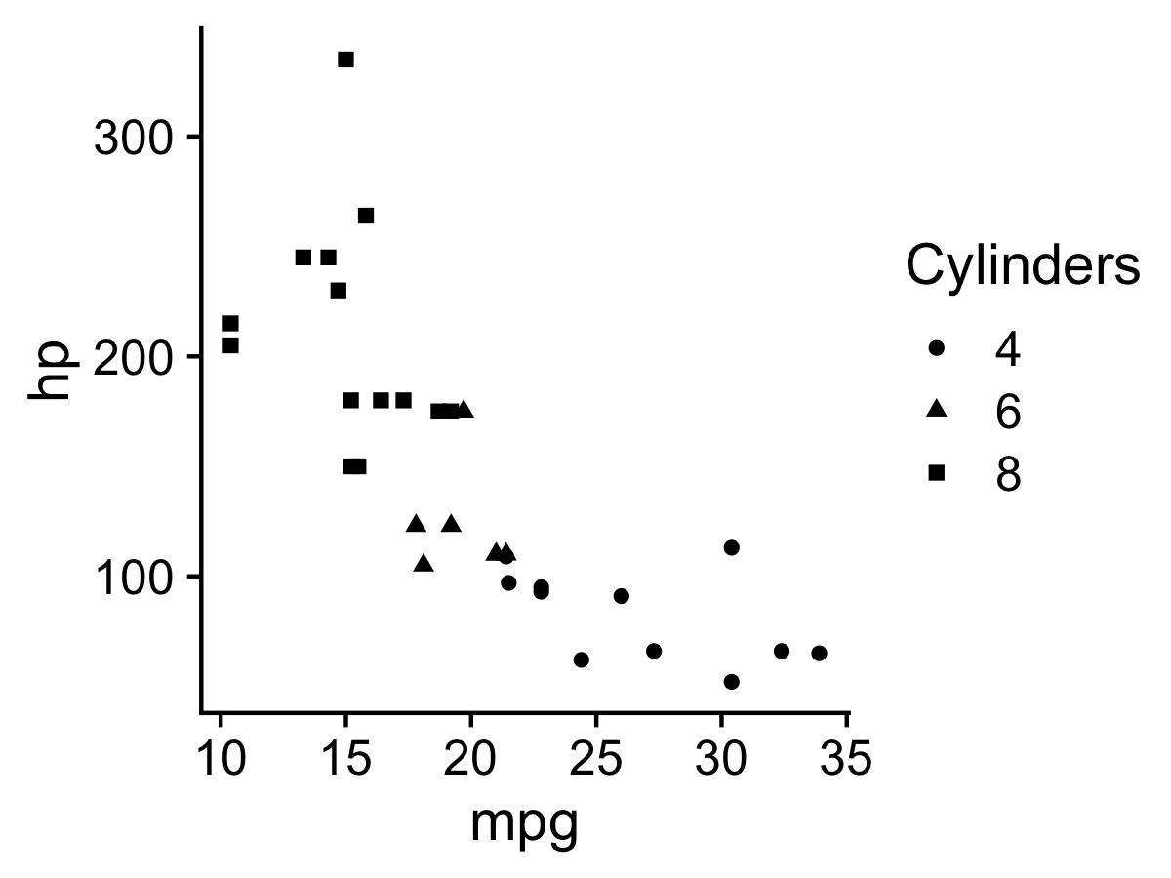
Law of similarity
We tend to see elements that are physically similar as part of the same object

Slide 63
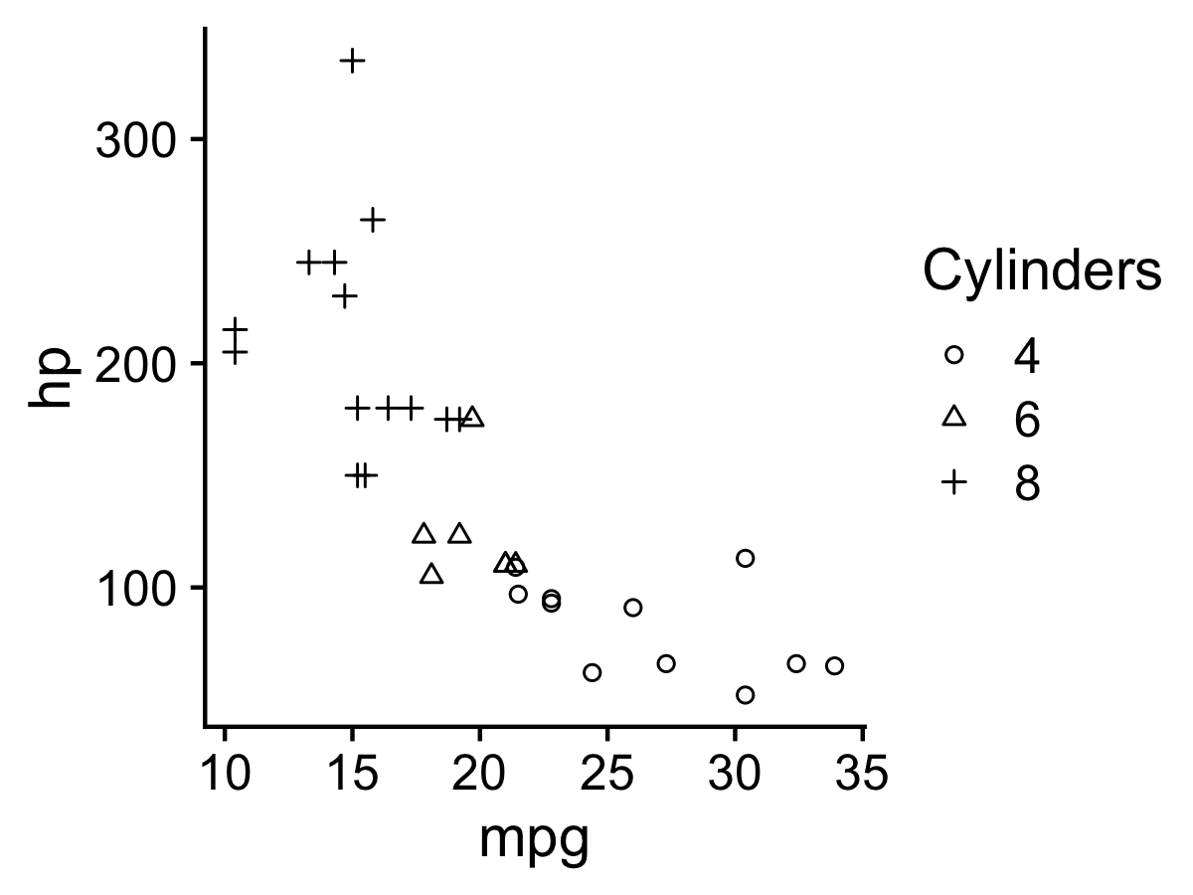
Law of similarity
We tend to see elements that are physically similar as part of the same object

Slide 64
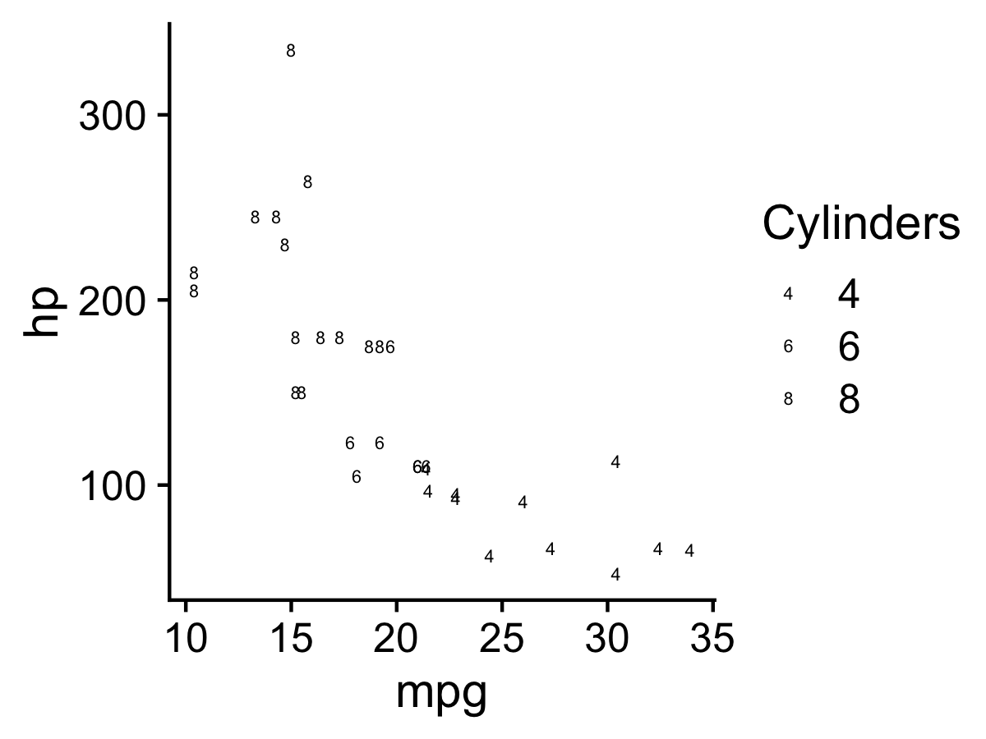
Law of similarity
We tend to see elements that are physically similar as part of the same object

Slide 65
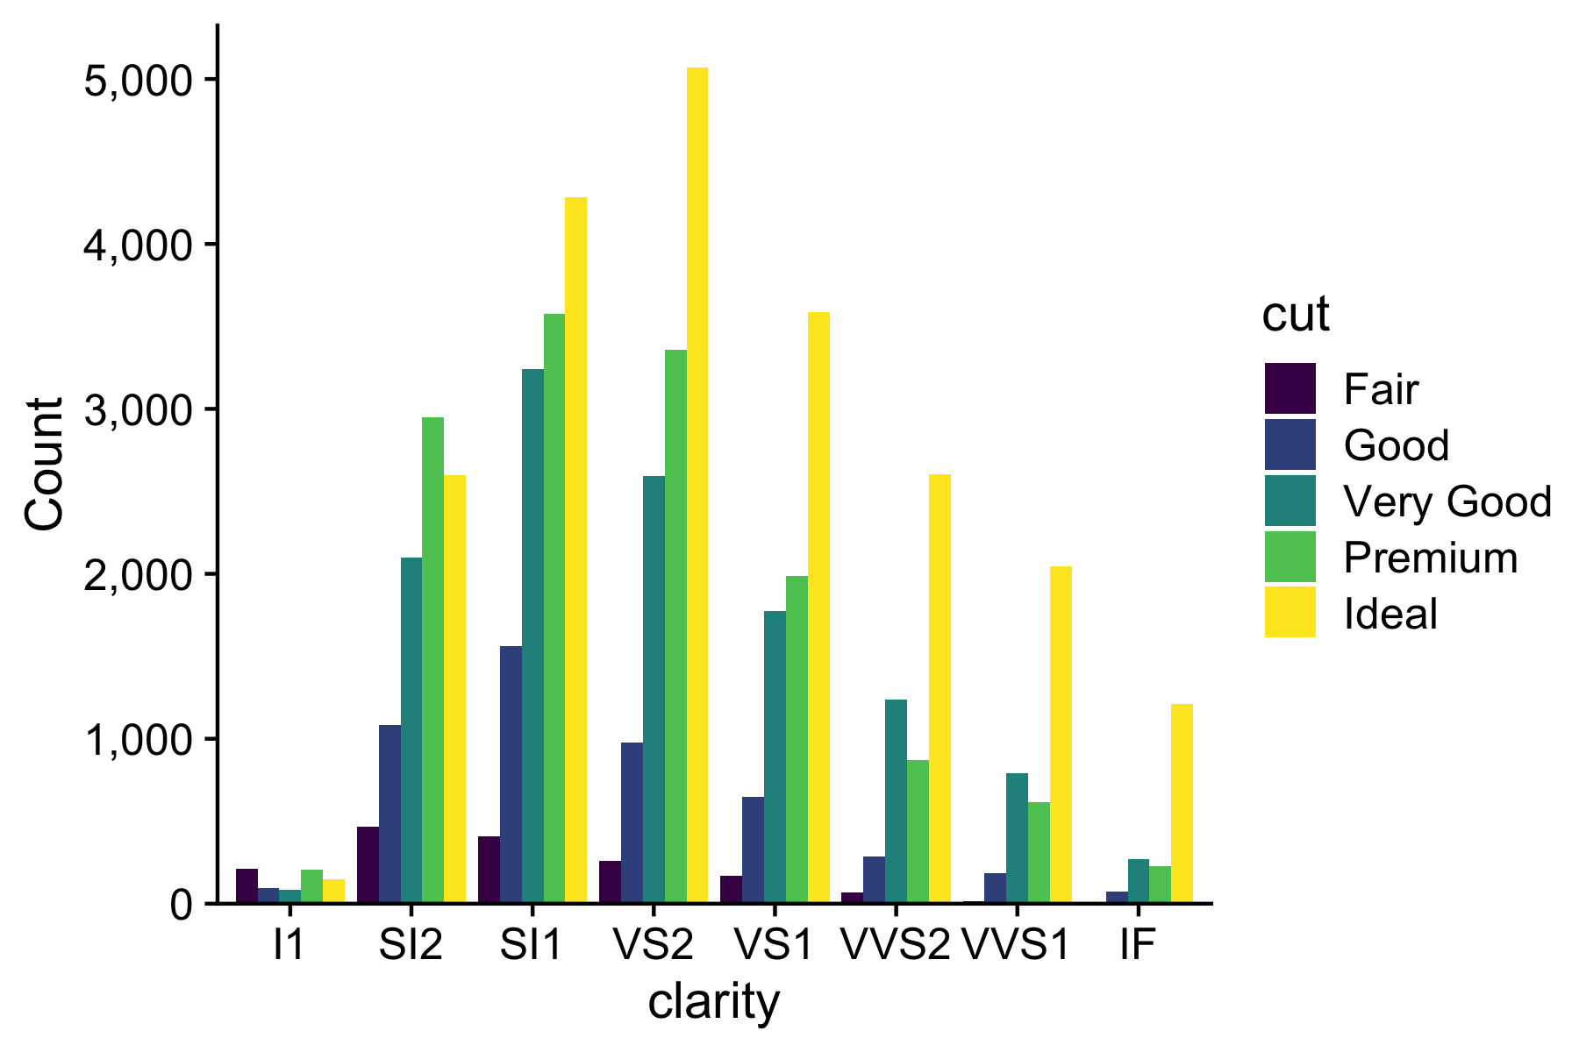
Law of proximity
We tend to see elements that are physically near each other as part of the same object

Slide 66
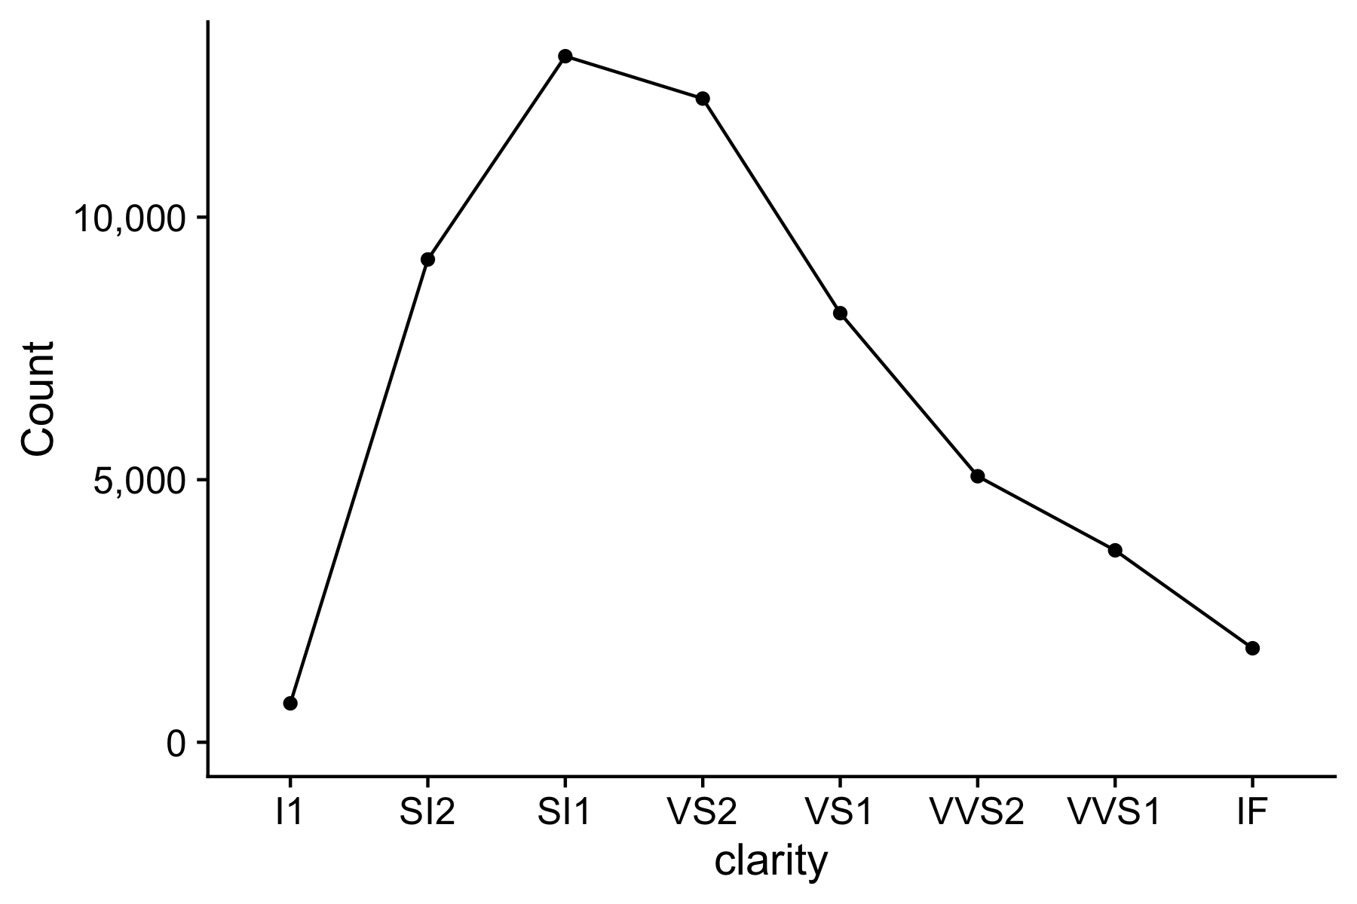
Law of proximity
We tend to see elements that are physically near each other as part of the same object
Notes:
Parallel coordinates plot

Slide 67
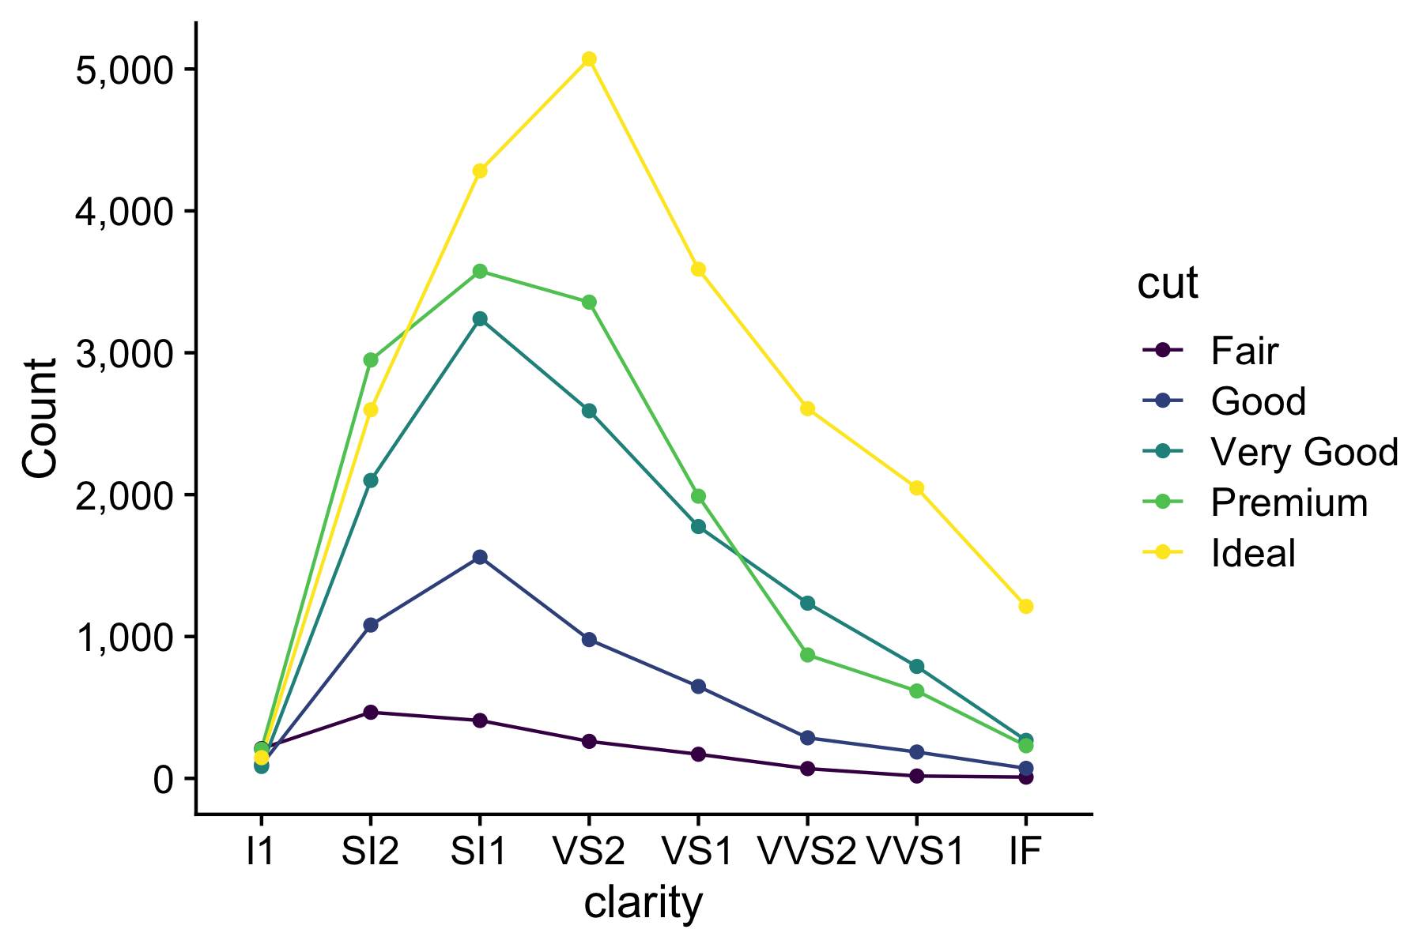
Law of proximity
We tend to see elements that are physically near each other as part of the same object
Notes:
Parallel coordinates plot

Slide 68
Cleveland’s three visual operations of pattern perception:
Estimation
Assembly
Detection
68

Slide 69
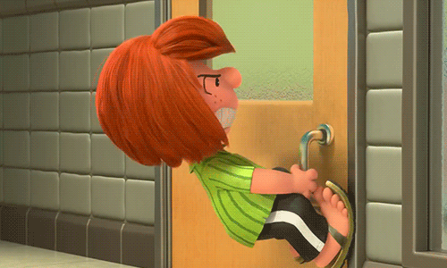

Slide 70

Norman door (n.):
A door where the design tells you to do the opposite of what you're actually supposed to do.
A door that gives the wrong signal and needs a sign to correct it.

Slide 71
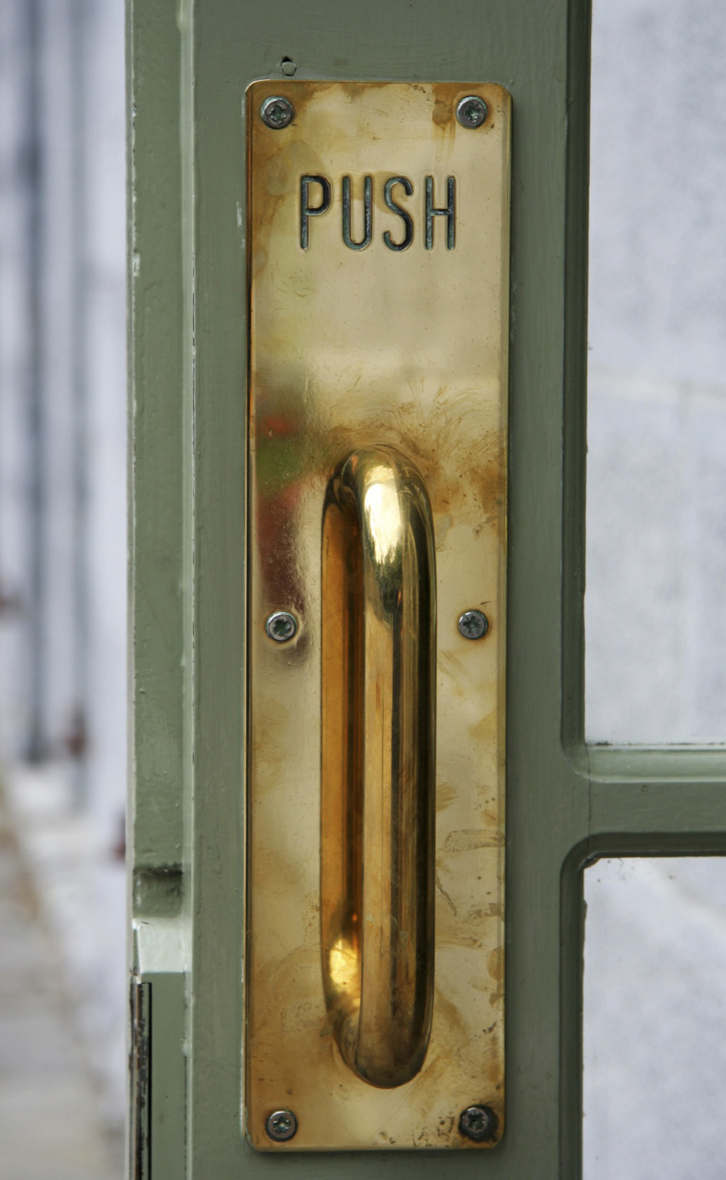
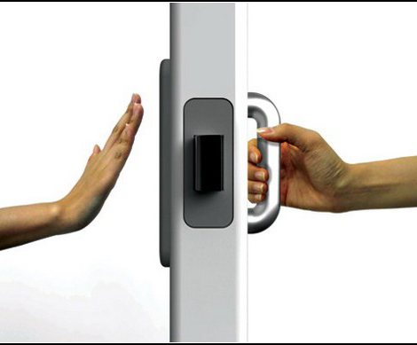
Norman door
Non-Norman door

Slide 72
Cleveland’s three visual operations of pattern perception:
Estimation
Assembly
Detection
Recognizing that a geometric object encodes a physical value
72

Slide 74
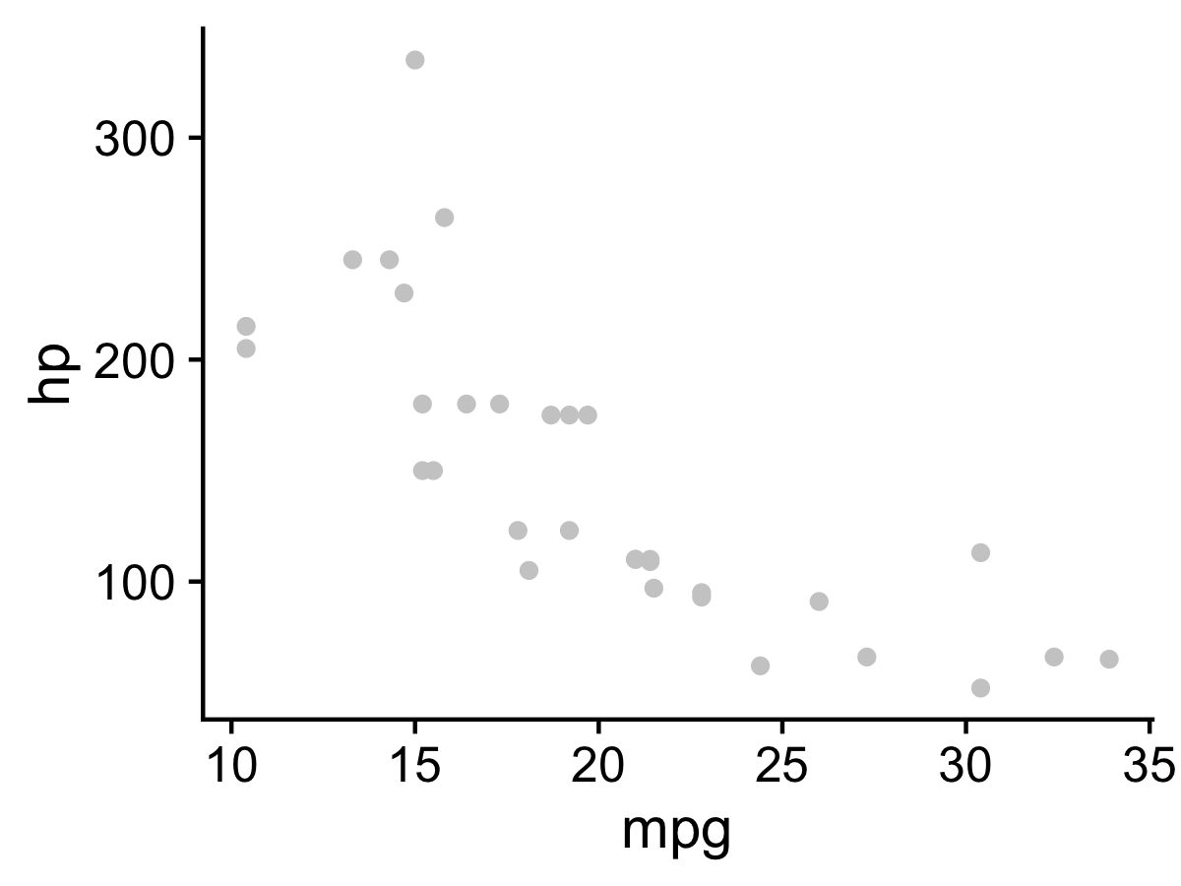

Slide 75


Slide 76
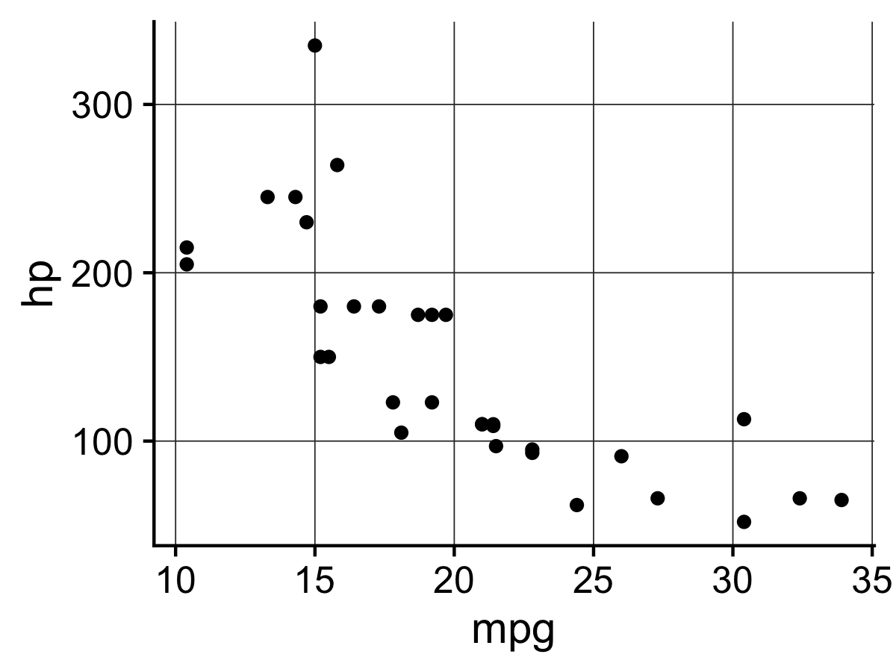

Slide 77
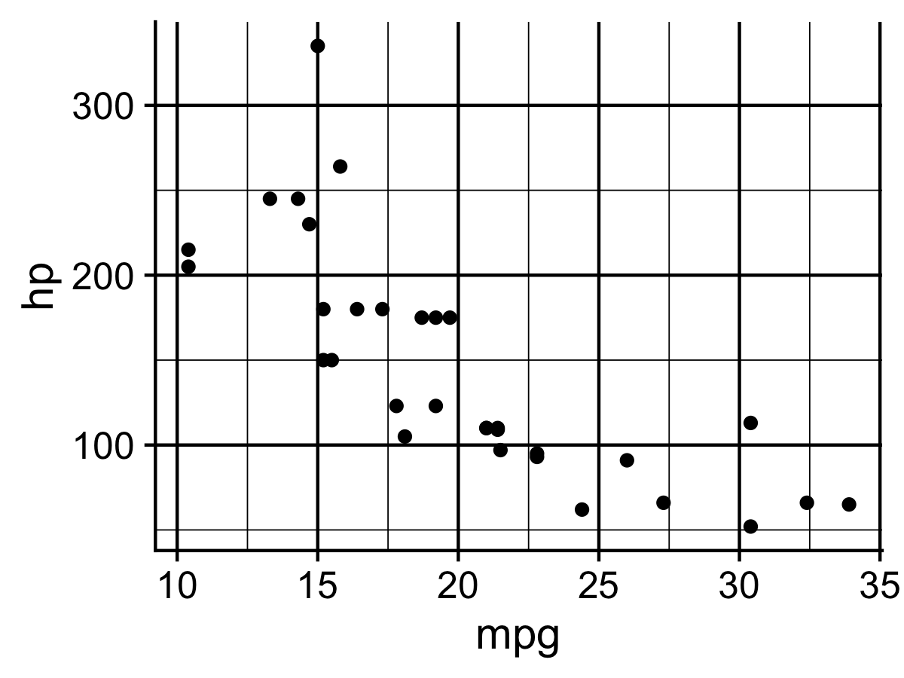

Slide 78
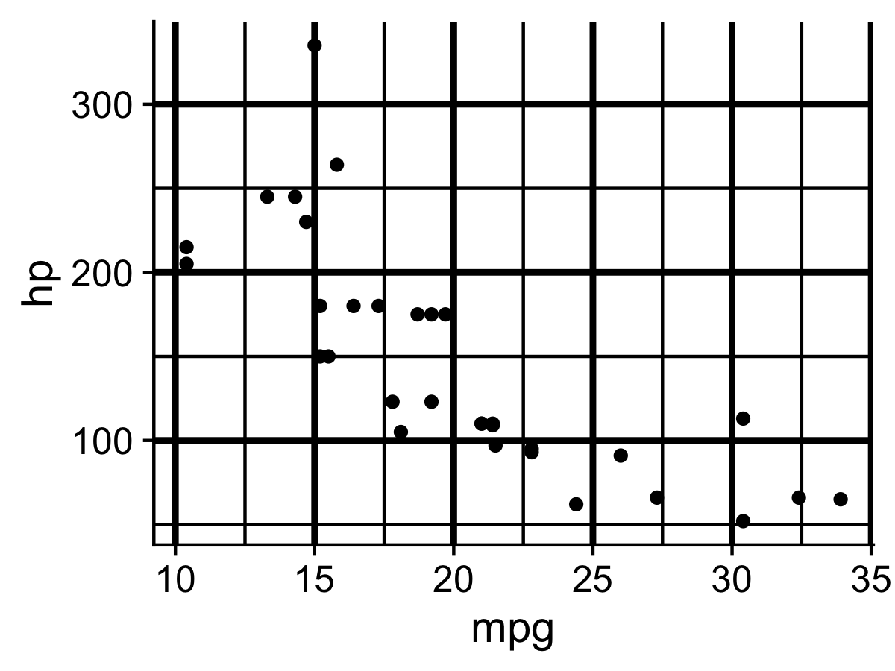

Slide 79
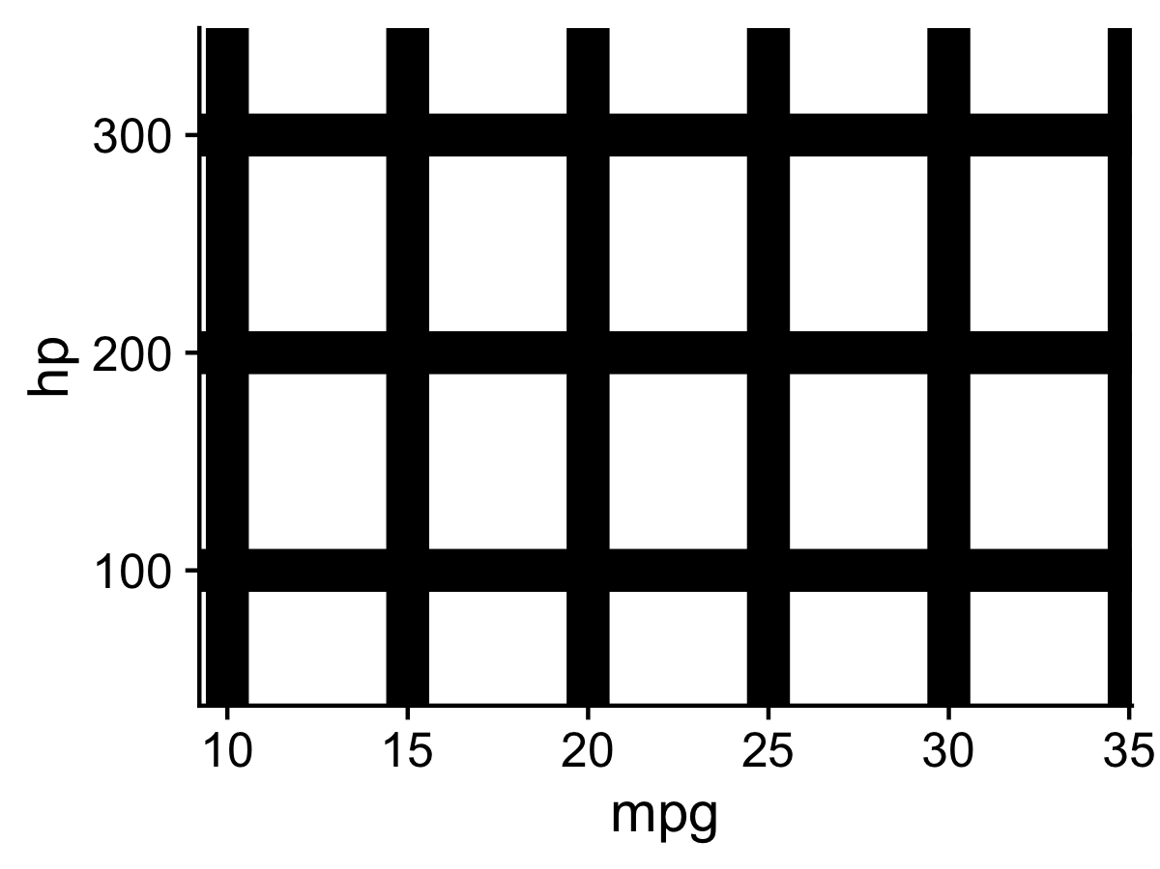
The Hermann Grid illusion

Slide 80
“Above all else, show the data” - Edward Tufte

Slide 81


Slide 82
10 lessons from research on visual perception
82

Slide 83
Don’t make 3D plots
Don’t use pie charts for proportions
Don’t stack bars
Don’t lie
Do rotate and sort categorical axes
Do eliminate legends & directly label geoms
Don’t use pattern fills
Don’t use red & green together
Do remove chart chunk
Do consider tables for small data sets
*...most of the time
83

Slide 84
Don’t: 3D plots
1) Humans are not that good at
distinguishing 3D space
M.C. Escher (1898-1972)
Upstairs and Downstairs
(1960; lithography)
https://en.wikipedia.org/wiki/Penrose_stairs

Slide 85

Don’t: 3D plots
1) Humans are not that good at
distinguishing 3D space
Ink proportions != true proportions
M.C. Escher (1898-1972)
Upstairs and Downstairs
(1960; lithography)
https://en.wikipedia.org/wiki/Penrose_stairs

Slide 86

Don’t: 3D plots
2) Occlusion: geoms are obscured

Slide 87

A better alternative to 3D: faceting

Slide 88


Don’t: 3D plots
3) The third dimension distracts from the data
(this is what Tufte calls “chart junk”)

Slide 89
Don’t make 3D plots
Don’t use pie charts for proportions
Don’t stack bars
Don’t lie
Do rotate and sort categorical axes
Do eliminate legends & directly label geoms
Don’t use pattern fills
Don’t use red & green together
Do remove chart chunk
Do consider tables for small data sets
*...most of the time
89

Slide 90
“Pie charts are the information visualization equivalent of a roofing hammer to the frontal lobe” - Coda Hale
Notes:
Which is larger: North Central or South?

Slide 91

Notes:
Which is larger: North Central or South?

Slide 92

Notes:
You experience more information than is explicitly present in an image

Slide 93
Don’t make 3D plots
Don’t use pie charts for proportions
Don’t stack bars
Don’t lie
Do rotate and sort categorical axes
Do eliminate legends & directly label geoms
Don’t use pattern fills
Don’t use red & green together
Do remove chart chunk
Do consider tables for small data sets
*...most of the time
93

Slide 94


Slide 95
Notes:
Parallel coordinates plot

Slide 96

Exception

Slide 97
Don’t make 3D plots
Don’t use pie charts for proportions
Don’t stack bars
Don’t lie
Do rotate and sort categorical axes
Do eliminate legends & directly label geoms
Don’t use pattern fills
Don’t use red & green together
Do remove chart chunk
Do consider tables for small data sets
*...most of the time
97

Slide 98






$$\frac{5.3 −0.6}{0.6}$$
Size of effect shown in graphic
Size of effect in data
$$7.83$$
“Lie Factor” =
=
=
= 14.8
$$\frac{27.5 −18}{18}$$
$$0.53$$
Edward Tufte (2001): The Visual Display of Quantitative Information, 2nd Edition, pg. 57-58
Notes:
Which is larger: North Central or South?

Slide 99

Do: Start bar charts at 0
Image from http://livingqlikview.com/the-9-worst-data-visualizations-ever-created/

Slide 100
Don’t make 3D plots
Don’t use pie charts for proportions
Don’t stack bars
Don’t lie
Do rotate and sort categorical axes
Do eliminate legends & directly label geoms
Don’t use pattern fills
Don’t use red & green together
Do remove chart chunk
Do consider tables for small data sets
*...most of the time

Slide 101



Slide 102

Default ordering is almost always wrong
Ordered by alphabet
Ordered by count

Slide 103
Don’t make 3D plots
Don’t use pie charts for proportions
Don’t stack bars
Don’t lie
Do rotate and sort categorical axes
Do eliminate legends & directly label geoms
Don’t use pattern fills
Don’t use red & green together
Do remove chart chunk
Do consider tables for small data sets
*...most of the time
103

Slide 104



Slide 105
Don’t make 3D plots
Don’t use pie charts for proportions
Don’t stack bars
Don’t lie
Do rotate and sort categorical axes
Do eliminate legends & directly label geoms
Don’t use pattern fills
Don’t use red & green together
Do remove chart chunk
Do consider tables for small data sets
*...most of the time
105

Slide 106

Don’t use pattern fills

Slide 107



Slide 108
Don’t make 3D plots
Don’t use pie charts for proportions
Don’t stack bars
Don’t lie
Do rotate and sort categorical axes
Do eliminate legends & directly label geoms
Don’t use pattern fills
Don’t use red & green together
Do remove chart chunk
Do consider tables for small data sets
*...most of the time

Slide 109


10% of males and 1% of females are color blind

Slide 110

Facets can be used to avoid color altogether

Slide 111
Don’t make 3D plots
Don’t use pie charts for proportions
Don’t stack bars
Don’t lie
Do rotate and sort categorical axes
Do eliminate legends & directly label geoms
Don’t use pattern fills
Don’t use red & green together
Do remove chart chunk
Do consider tables for small data sets
*...most of the time
111

Slide 112

Figure 24.1: From Data Looks Better Naked by Darkhorse Analytics

Slide 113

Figure 24.1: From Data Looks Better Naked by Darkhorse Analytics

Slide 114
Don’t make 3D plots
Don’t use pie charts for proportions
Don’t stack bars
Don’t lie
Do rotate and sort categorical axes
Do eliminate legends & directly label geoms
Don’t use pattern fills
Don’t use red & green together
Do remove chart chunk
Do consider tables for small data sets
*...most of the time
114

Slide 115


Slide 116


Slide 117
Who do you think did a better job in tonight’s debate?
 | Clinton | Trump
Among democrats | 99% | 1%
Among republicans | 53% | 47%

Slide 118
Two objectives of effective graphs:
Grab & direct attention (iconic memory)
Reduce processing demands (working memory)
Graph components:
Geoms:
points, lines, boxes, bars, etc.
Pre-attentive attributes:
position, color, shape, curvature, etc.
Non-data ink:
scales, grid lines, legend, labels, etc.
No chart junk!
Pattern recognition hierarchy:
Position on a common scale
Position on non-aligned scales
Length
Angle
Area
Color saturation
Color hue
Cleveland’s three visual operations of pattern perception:
Estimation:
Discrimination X != Y
Ranking X > Y
Ratioing X / Y
Assembly:
The grouping of graphical elements
Prägnanz: We strongly prefer to interpret stimuli as regular, simple, and orderly
Detection:
Recognizing that a geometric object encodes a physical value
Above all else, show the data
10 lessons* from research on visual perception:
Don’t make 3D plots
Don’t use pie charts for proportions
Don’t stack bars
Don’t lie
Do rotate and sort categorical axes
Do eliminate legends & directly label geoms
Don’t use pattern fills
Don’t use red & green together
Do remove chart chunk
Do consider tables for small data sets
*most of the time

Slide 119
Your turn
1) Identify the following:
The geoms
The pre-attentive attributes
Where the graphic falls on Cleveland’s pattern recognition hierarchy
2) Identify the design rules that are broken (if any)
3) Suggest at least two improvements
119

Slide 120

120
https://people.howstuffworks.com/prison4.htm

Slide 121

121
Figure 1.4 in Healy, 2018

Slide 122


122
Figure 1.4 in Healy, 2018

Slide 123

123
http://www.wallstats.com/blog/down-the-rabbit-hole-of-the-pentagon-graphics-machine/

Slide 124

Ou et al., 2019 "Light-duty plug-in electric vehicles in China: An overview on the market and its comparisons to the United States"
124

Slide 125


125

Slide 126


126

Slide 127

127

Slide 128
Extra Slides

Slide 129


129

Slide 130
130

Slide 131

Notes:
Our brain perceives objects that are lighter at the top as concave

Slide 132
Notes:
Our brain perceives objects that are lighter at the top as concave

Slide 133
Do: Consider using graphs instead of tables
Helveston, J. P., Y. Liu, E. M. Feit, E. Fuchs, E. Klampﬂ, J.J. Michalek (2015) “Will subsidies drive electric vehicle adoption? Measuring consumer preferences in the U.S. and China.” Transportation Research Part A: Policy and Practice, 73, 96–112.

Slide 134

Do: Consider using graphs instead of tables
Helveston, J. P., Y. Liu, E. M. Feit, E. Fuchs, E. Klampﬂ, J.J. Michalek (2015) “Will subsidies drive electric vehicle adoption? Measuring consumer preferences in the U.S. and China.” Transportation Research Part A: Policy and Practice, 73, 96–112.

Slide 135

Gradient:
Change in continuous variable

Slide 136
Gradient:
Change in continuous variable
Discrete:
Identify (a few) categorical variables

Slide 137

Tables:
Data organized into rows and columns
Graphs:
Visual representation of information in tables
Mammal | Body (kg) | Brain (g)
Arctic fox | 3.385 | 44.5
Owl monkey | 0.48 | 15.5
Mountain beaver | 1.35 | 8.1
Cow | 465 | 423
Grey wolf | 36.33 | 119.5
Goat | 27.66 | 115
Diagrams:
Visual representation of a process

Slide 138
Tables:
Data organized into rows and columns
Graphs:
Visual representation of information in tables
Mammal | Body (kg) | Brain (g)
Arctic fox | 3.385 | 44.5
Owl monkey | 0.48 | 15.5
Mountain beaver | 1.35 | 8.1
Cow | 465 | 423
Grey wolf | 36.33 | 119.5
Goat | 27.66 | 115
Diagrams:
Visual representation of process

Slide 139
“Visualizing data helps us think¹”
 | A |  | B |  | C |  | D
 | x | y | x | y | x | y | x | y
 | 10 | 8.04 | 10 | 9.14 | 10 | 7.46 | 8 | 6.58
 | 8 | 6.95 | 8 | 8.14 | 8 | 6.77 | 8 | 5.76
 | 13 | 7.58 | 13 | 8.74 | 13 | 12.74 | 8 | 7.71
 | 9 | 8.81 | 9 | 8.77 | 9 | 7.11 | 8 | 8.84
 | 11 | 8.33 | 11 | 9.26 | 11 | 7.81 | 8 | 8.47
 | 14 | 9.96 | 14 | 8.1 | 14 | 8.84 | 8 | 7.04
 | 6 | 7.24 | 6 | 6.13 | 6 | 6.08 | 8 | 5.25
 | 4 | 4.26 | 4 | 3.1 | 4 | 5.39 | 19 | 12.5
 | 12 | 10.84 | 12 | 9.13 | 12 | 8.15 | 8 | 5.56
 | 7 | 4.82 | 7 | 7.26 | 7 | 6.42 | 8 | 7.91
 | 5 | 5.68 | 5 | 4.74 | 5 | 5.73 | 8 | 6.89
Sum: | 99 | 82.51 | 99 | 82.51 | 99 | 82.5 | 99 | 82.51
Mean: | 9 | 7.5 | 9 | 7.5 | 9 | 7.5 | 9 | 7.5
St. Dev: | 3.3 | 2 | 3.3 | 2 | 3.3 | 2 | 3.3 | 2
1. Stephen Few (2009, pg. 6)

Slide 140

“Visualizing data helps us think¹”
1. Stephen Few (2009, pg. 6)

